Slide 1
Clouds

Slide 2
Cloud
Collection of tiny water droplets formed when a parcel (piece) of air has cooled slightly below its dew point.
Clouds are classified by height above ground and their form.
Water vapor condenses on…
Condensation Nuclei

Slide 3
Condensation Nuclei
Small particle that water vapor condenses on to form a cloud.
Examples: dust, soot, sea salt

Slide 4
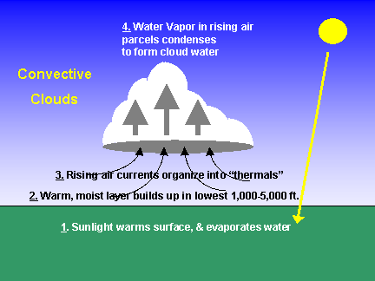
Cloud Formation
1.) Warm, moist air rises
2.) As air is rising, temperature
cools
3.) Air eventually cools to the
dew point
4.) Water vapor condenses onto
condensation nuclei
5.) A cloud begins to form

Slide 5
Cloud Roots & Translations

Slide 6
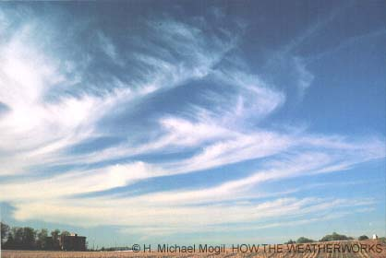
Cirr0-
“Curl,” describes a high cloud made of wispy ice crystals

Slide 7
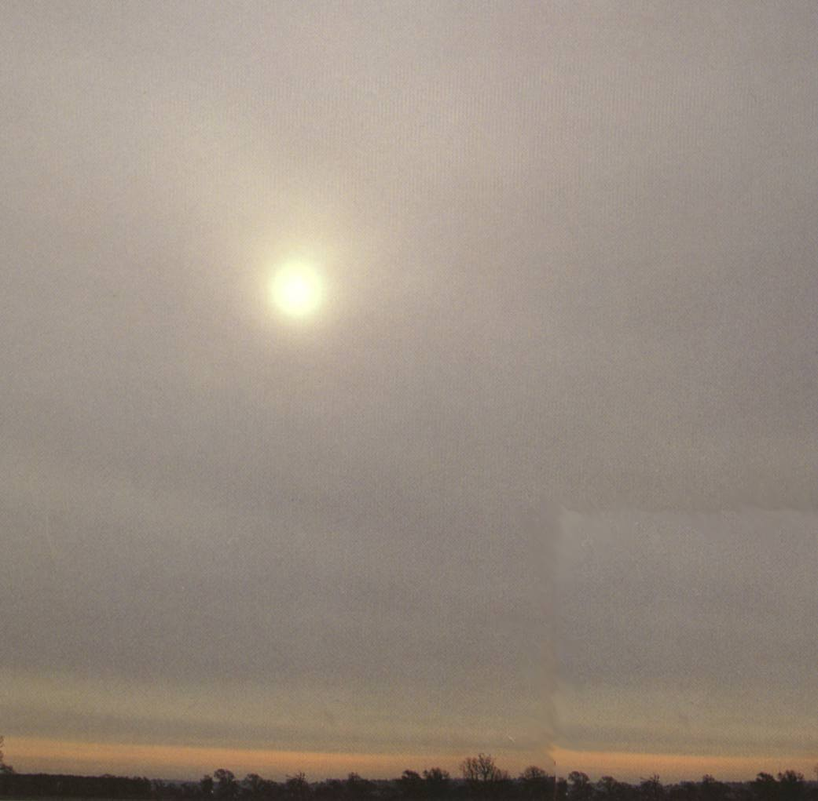
Alto
“Middle/High,” cloud is in the middle of the troposphere below the cirro- clouds

Slide 8
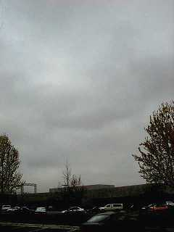
Strato-
“Sheet-like/Expand,” can spread out large enough to cover the whole sky; forms low layers

Slide 9
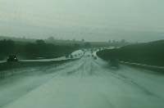
Nimbo-
“Water,” gray cloud indicating the cloud is producing precipitation

Slide 10
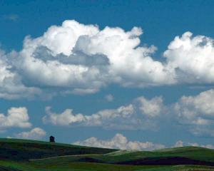
Cumulo-
“Heap or pile,” white puffy clouds

Slide 11
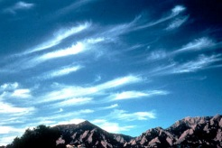
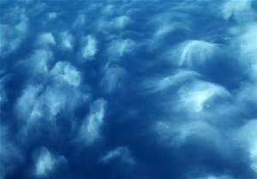
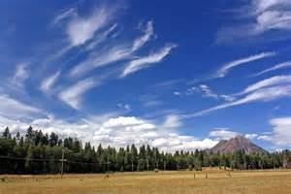
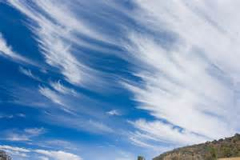
Cirrus

Slide 12
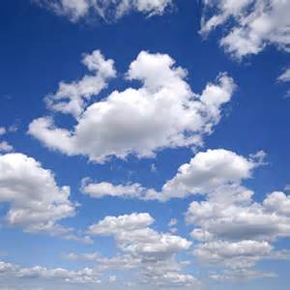
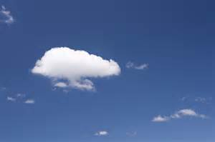
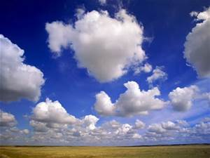
Cumulus

Slide 13
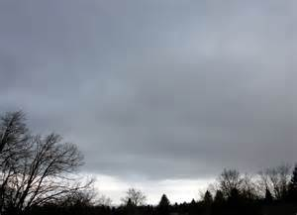
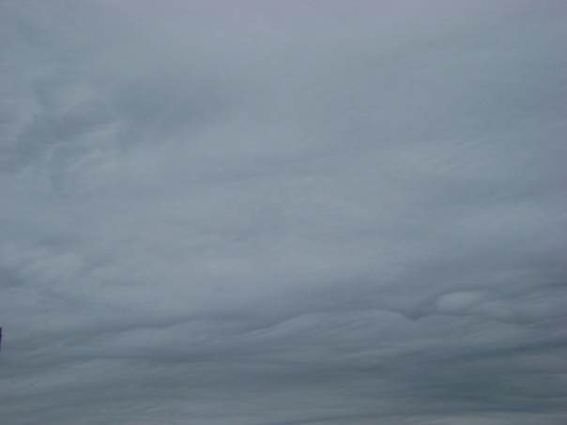
Stratus

Slide 14
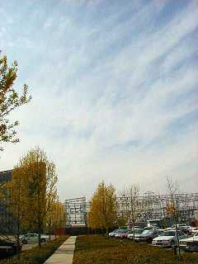
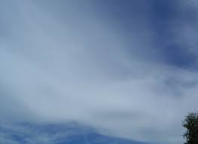
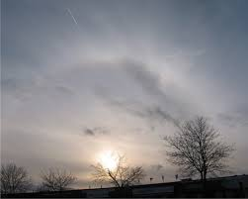
Cirrus
Stratus
Cirrostratus

Slide 15
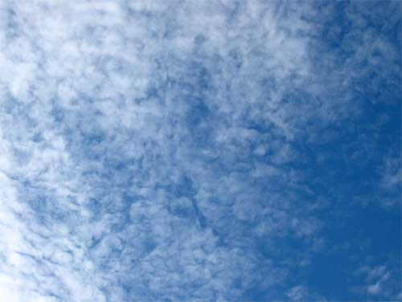
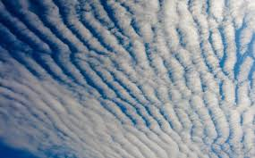
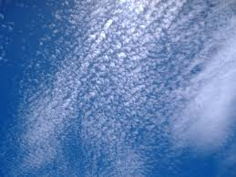
Cirrus
Cumulus
Cirrocumulus

Slide 16
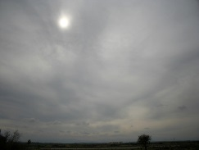
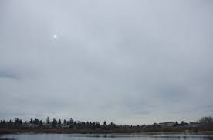
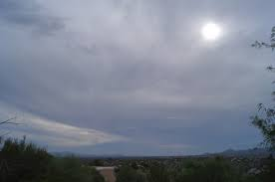
Stratus
Altostratus

Slide 17
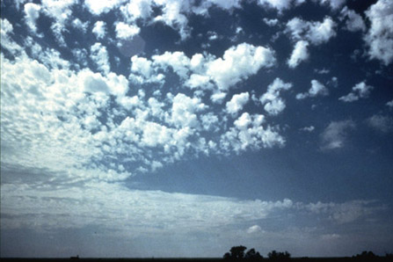
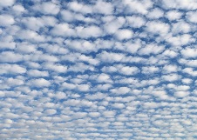
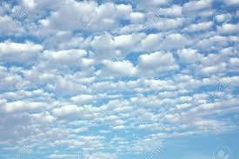
Cumulus
Altocumulus

Slide 18
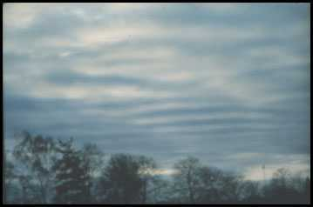
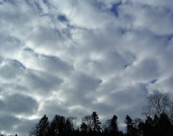
Stratus
Cumulus
Stratocumulus

Slide 19
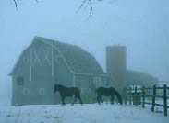
Nimbostratus

Slide 20
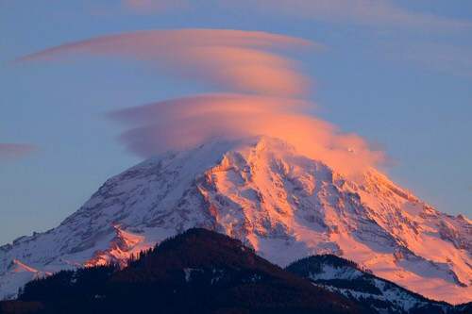
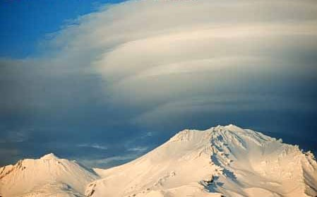
Lenticular

Slide 21
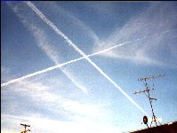
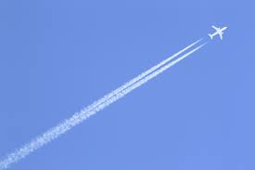
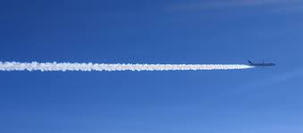
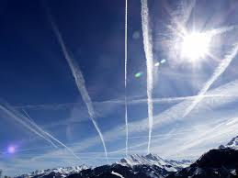
Contrails

Slide 22
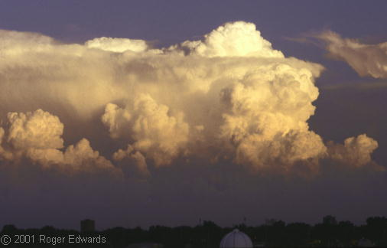
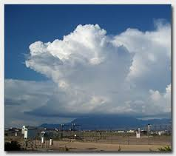
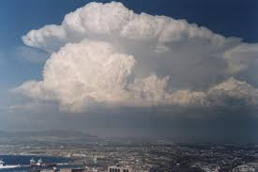
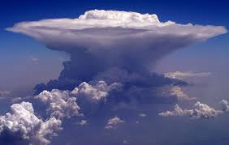
Cumulonimbus

Slide 23
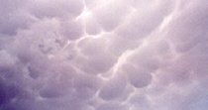
Mammatus

Slide 24
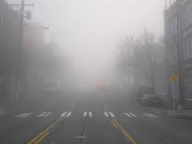
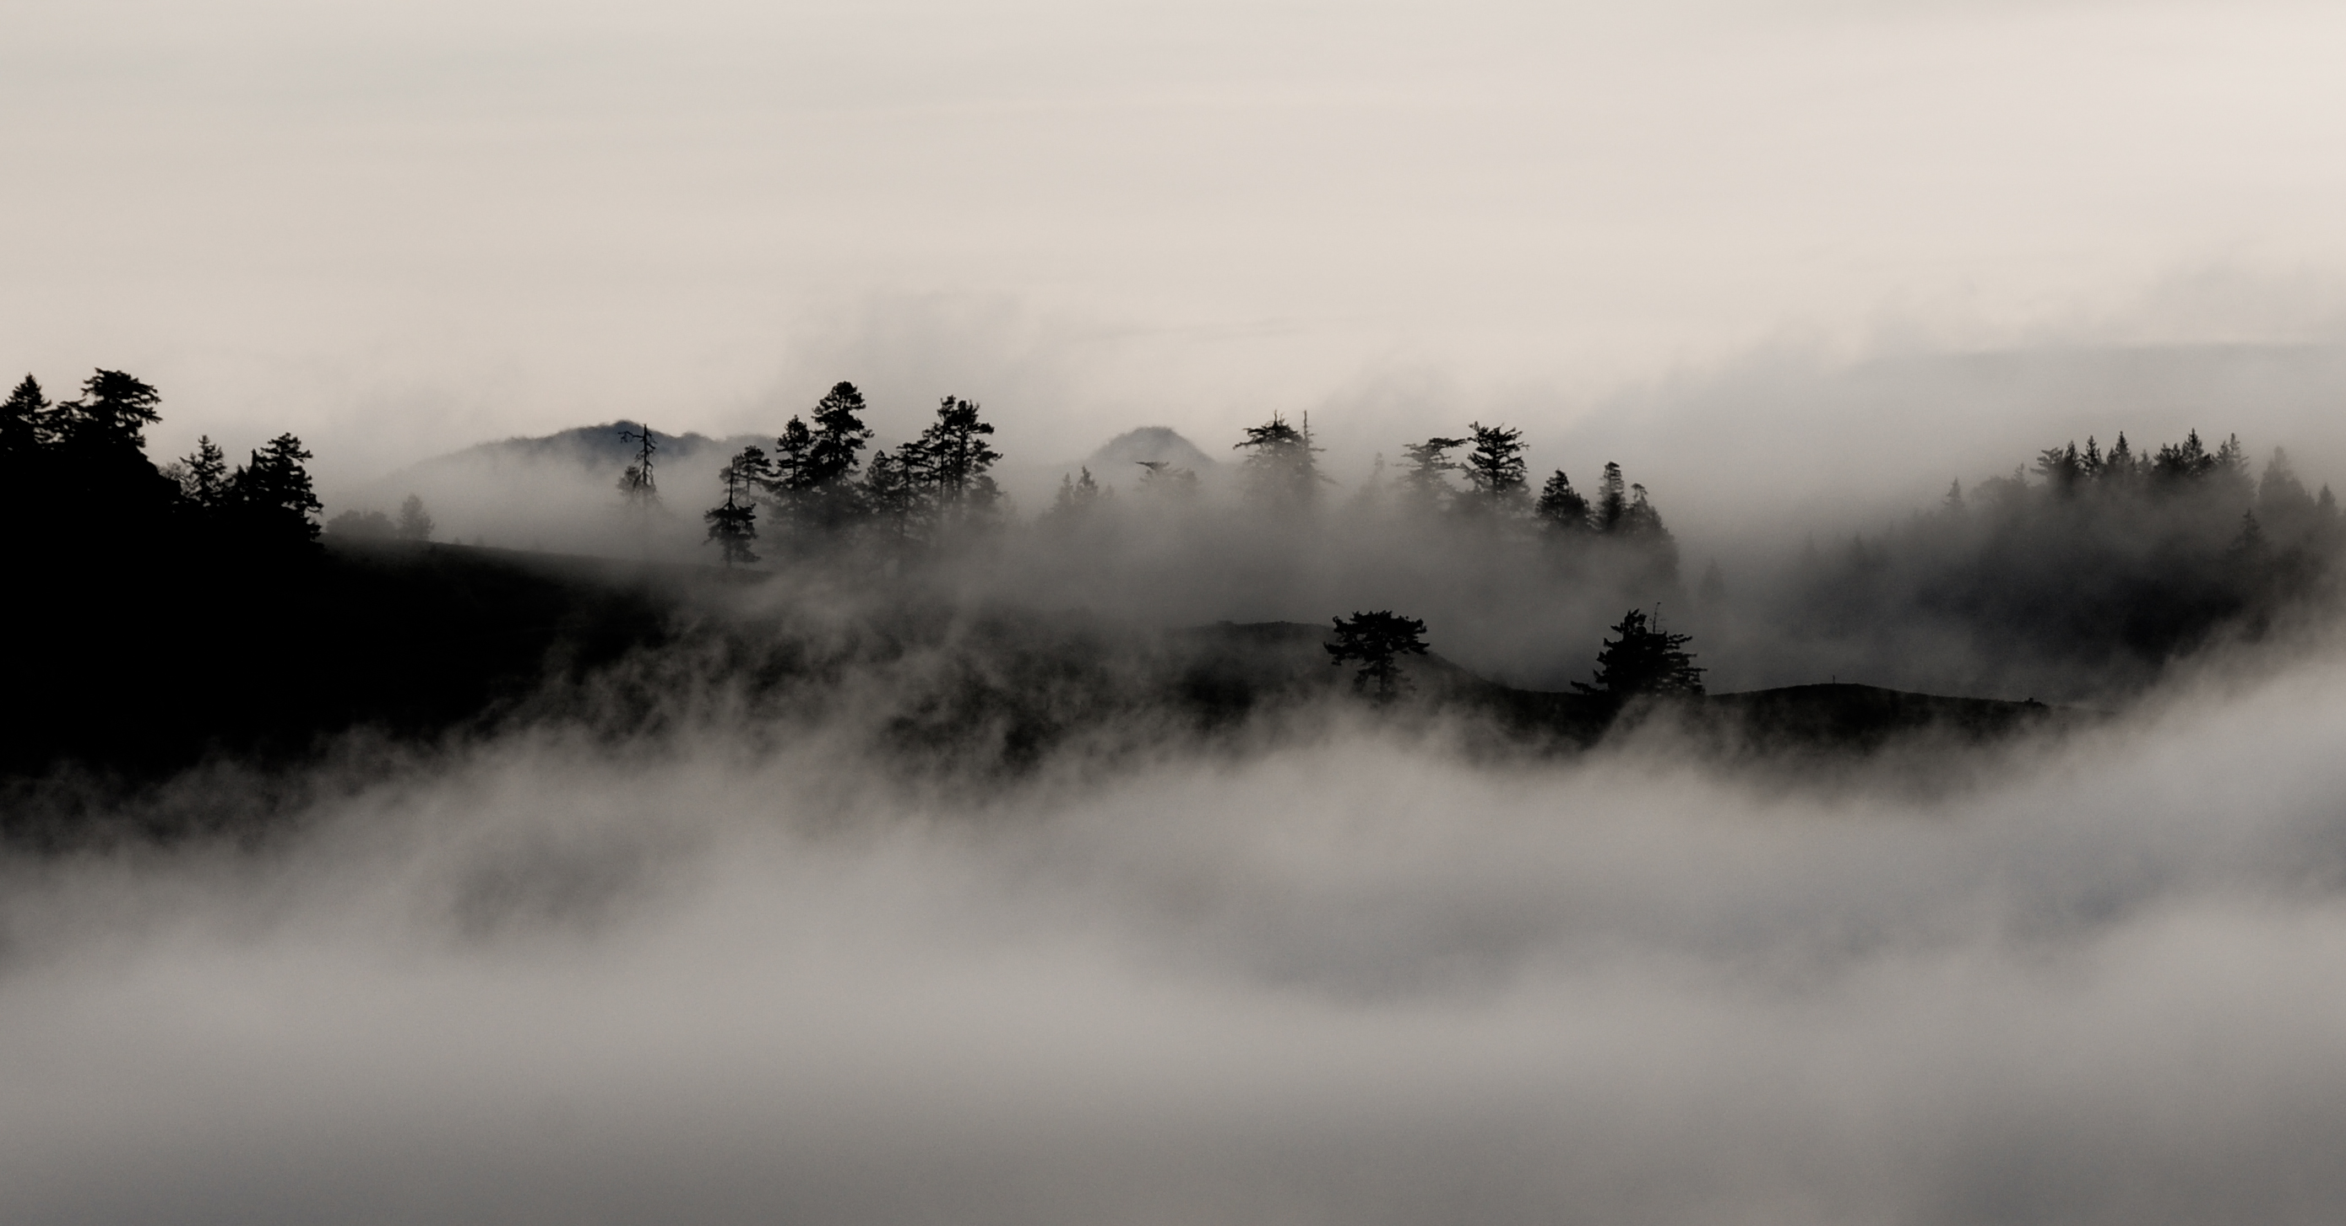
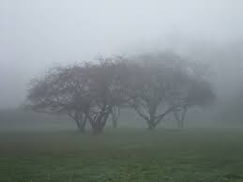
Fog

Slide 25
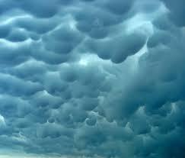
Mammatus

Slide 26
Cumulonimbus

Slide 27
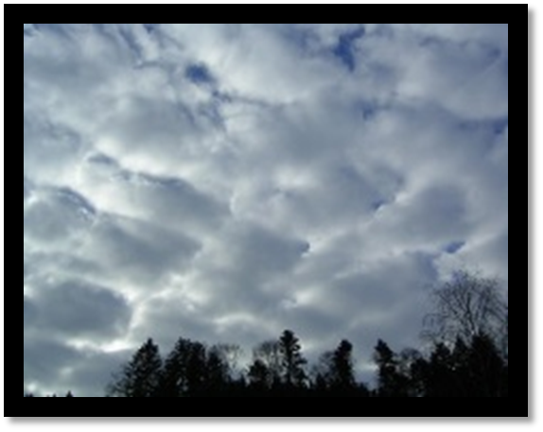
Stratocumulus

Slide 28
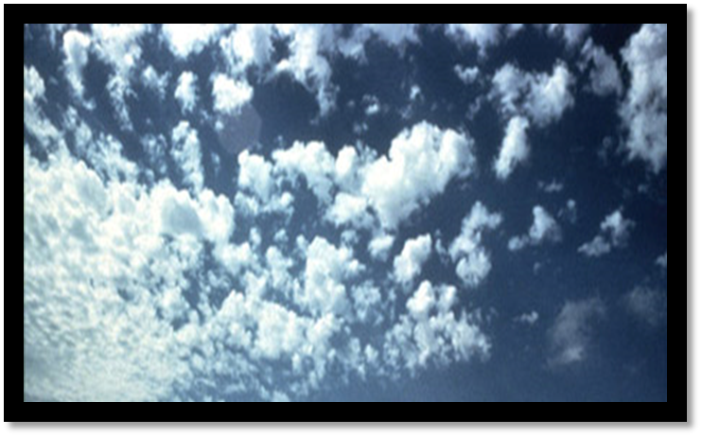
Altocumulus

Slide 29
Fog

Slide 30
Cirrus

Slide 31
Contrails

Slide 32
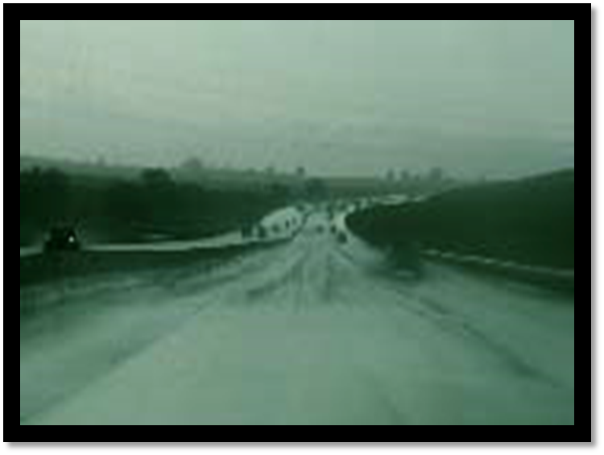
Nimbostratus

Slide 33
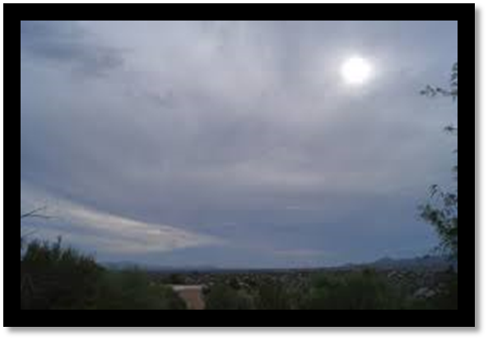
Altostratus

Slide 34
Lenticular

Slide 35
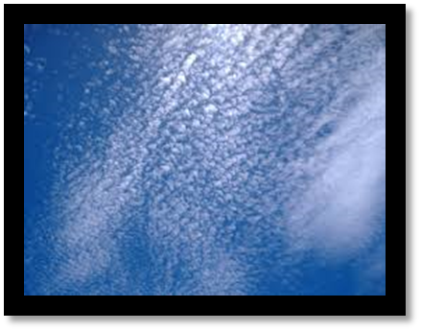
Cirrocumulus

Slide 36
Cumulus

Slide 37
Cirrostratus

Slide 38
Stratus

