Slide 1
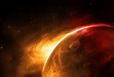
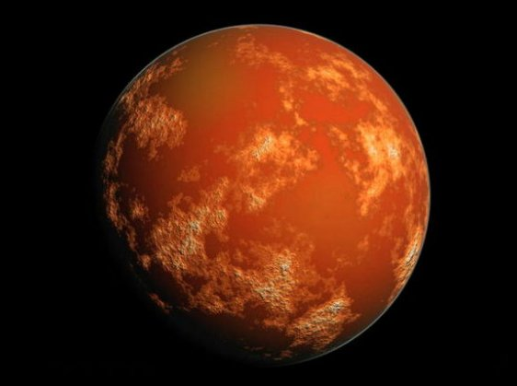
Mars Planet Project
By: Elizabeth Fisher , Cora Barrett, Riley Davis, Hunter Meehan

Slide 2
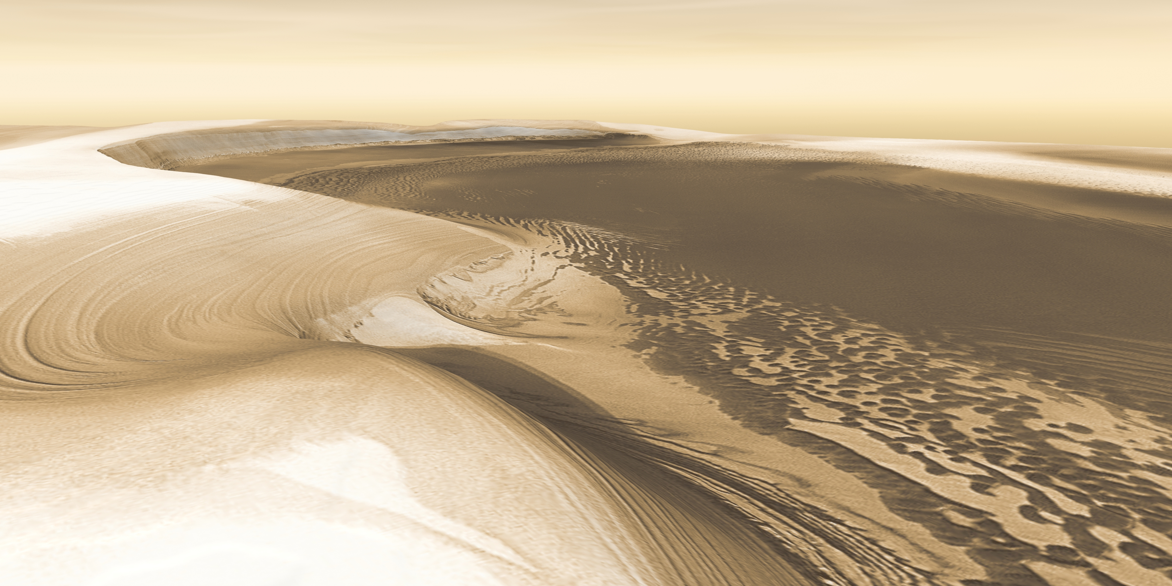
What the planet looks like?
It has red sand covering the surface with volcano and craters.
It has ice caps, canyons and deserters.
Some of the feature's ARE LIKE THE ONE ON THE MOON AND EARTH.
IT HAS A REDISH COLOR

Slide 3
How long is mars orbit it takes 687 earth days

Slide 4
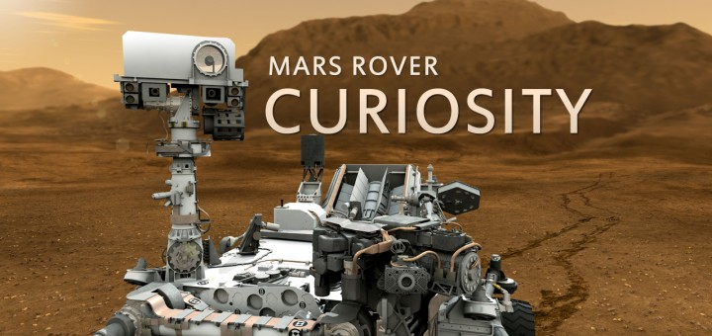
Have we explored mars?
YES we have. successful Past missions-Curiosity, ,Mars Exploration Rover Spirit
Mars Pathfinder & Sojourner, Global Surveyor, Viking 1,viking 2 Mars 2,3, 5, 6 Mariner 9,6,7,4

Slide 5
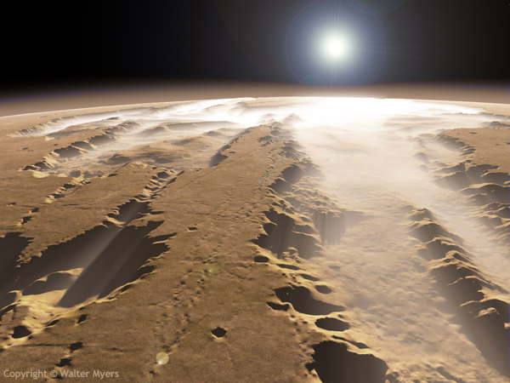
What features are found on the planet?
It is rocky with canyons, volcanos and craters all over. There are also gullies, which are small valleys or ravines originally worn away by running water and serving as a drainageway after prolonged heavy rains. There is also the Medusae Fossae formation, which is a soft, easily eroded deposit that extends for nearly 1,000 km along the equator of mars. The ridges in the formation generally point in the direction of the winds that carved them.

Slide 6
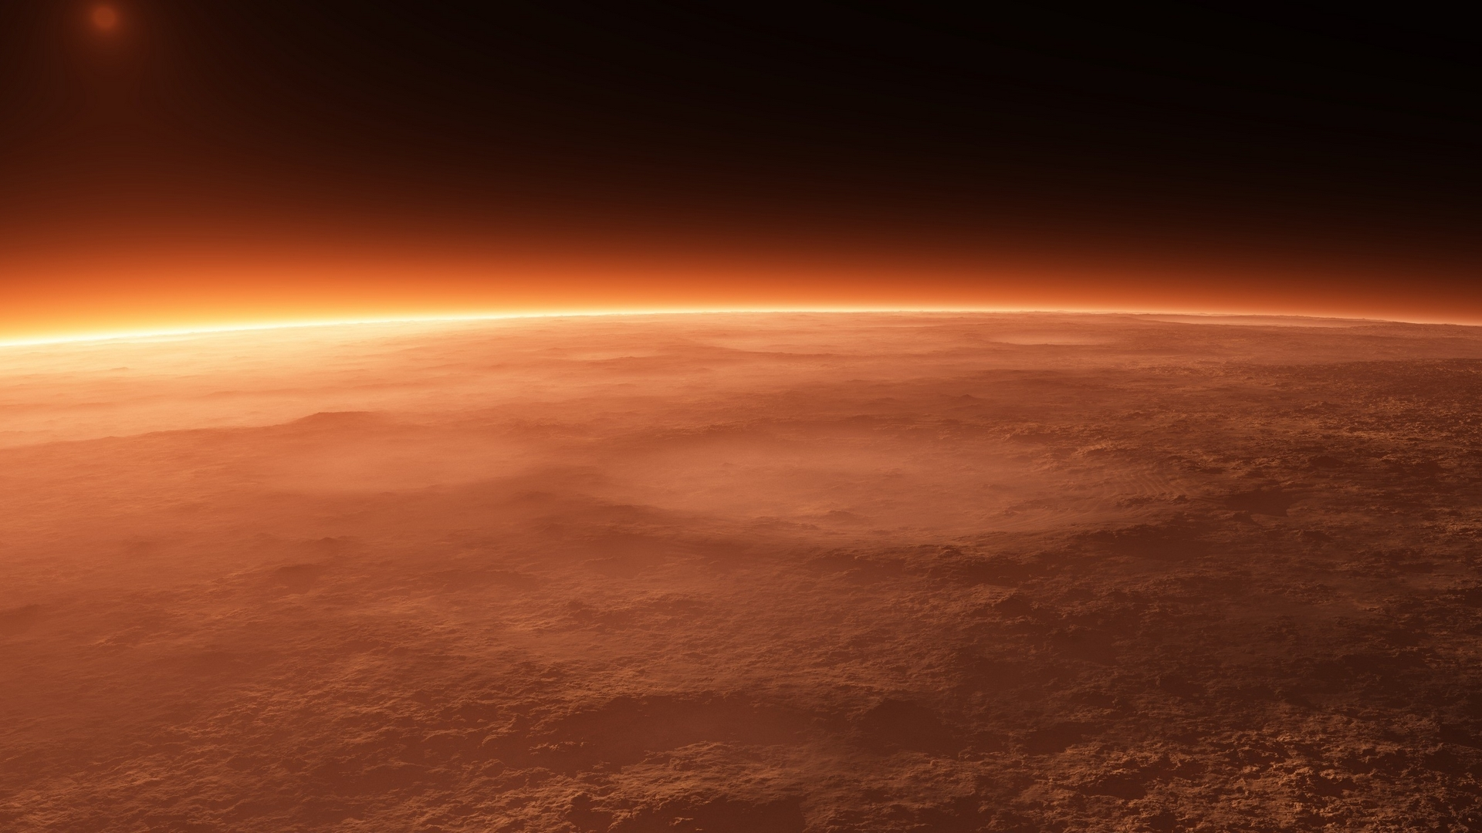
What type of atmosphere does your planet have? What gasses are present?
The atmosphere of mars is 100 times thinner than Earth's. The atmosphere is 95.32% Carbon dioxide, 2.7% nitrogen, 1.6% argon, 0.13% oxygen, 0.08% carbon monoxide. Also, minor amounts of water, nitrogen oxide, neon, hydrogen-deuterium-oxygen, krypton and xenon.
The atmospheric pressure on mars is only a fraction of what it is here on earth- averaging 7.5 millibars on mars to just over 1,000 here on earth.

Slide 7
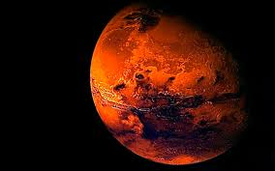
What is the average temperature?
The average temperature is -80° f which is also -60° c. Without a "thermal blanket" Mars can not retain any heat energy, this is why Mars's temperatures are so cold. On a normal summer day mars's temperature can reach up too 70° f (20° c). On a normal winter day it can go down to -195° f (125° c)

Slide 8
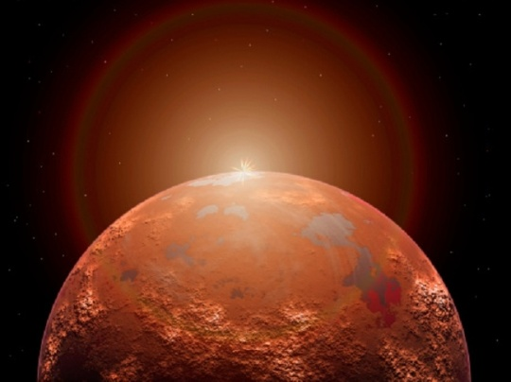
What is the gravity like on the planet?
The gravity on mars' surface is much lower than on earth, by 62%. At just 0.38 of the earth standard, a person who weighs 100 kg on earth would weigh 38 kg on mars.
The difference in gravity from earth to mars is due to some factors- mass, density, ad radius having the most effect. Even though mars has about the same land surface area as earth, it only has ½ the diameter and less density than earth, having about 15% of earth's volume, and 11% of its mass.

Slide 9
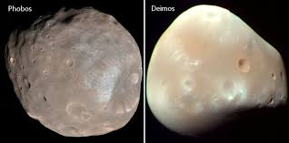
How many moons does mars have?
Phobos and Deimos are the 2 moons in mars.
MArs moons are one of the smallest in the solar system.
Asaph Hall discovered the moons one august night he almost gave up but his wife told him not to the next night he discovered one 9 days later he discovered another.
They are named after the mythological sons of Ares.
Phobos means fear or panic.
Deimos means flight.

Slide 10
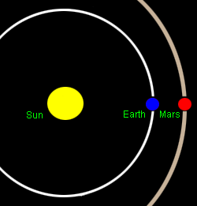
How far is mars from the sun
Mars is 1.523662 A.U from the sun.
Mars is 227,943,824 km from the sun.
Mars is 141,637,725 miles from the sun.
It was discovered by Known by the Ancients.

Slide 11
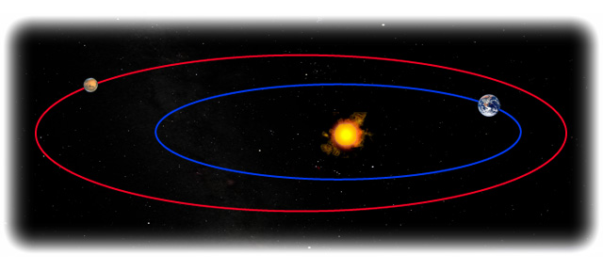
How long is the spin/rotation?
Mars rotation time is 24 hours, 39 minutes, and 35 sec. the "solar day" time is 24 hours, 37 minutes, and 22 sec. " solar day" means the time between successive meridian transits of the sun at a particular place.
Fun fact: Mars rotates about 40 minutes slower then earth.

Slide 12
What is the diameter(km), mass(kg) and density (g/cm3) of the planet
Mars diameter is 4,220 miles (6,792 km) and its mass is 6.4169 x 1023 kg, (3.93 g/cm³)

Slide 13
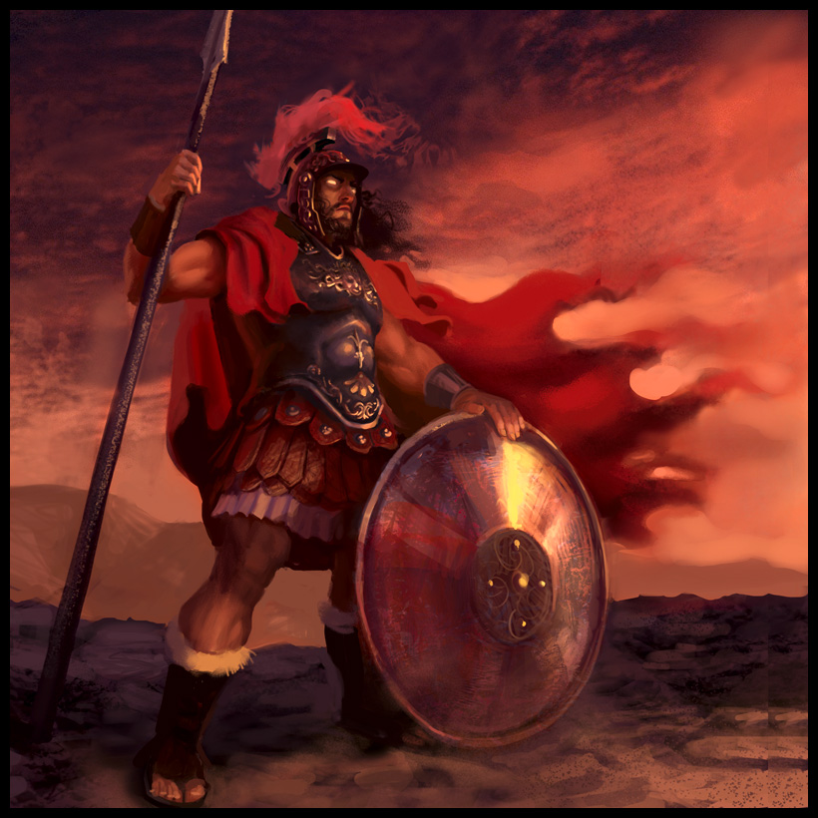
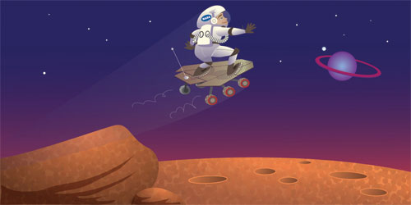
Interesting facts about mars
The planet mars was named after a roman god of war. It was known to the ancient Greeks as ares, their god of war.
Pieces of mars has been found on earth.
Mars was thought to be home of intelligent life.

