Slide 1
MATTER

Slide 2
MATTER
Anything that has mass and volume (made up of “stuff” and takes up space)
Exists in 4 states (phases)
  1. Solids
  2. Liquids
  3. Gases
  4. Plasmas

Slide 3
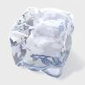
SOLID
Has a definite shape and a definite volume
Tightly packed particles

Slide 4


LIQUID
Has a definite volume but NO definite shape (takes the shape of its container)
Particles are not held together as tightly
Particles are free to move
(flow around each other)

Slide 5
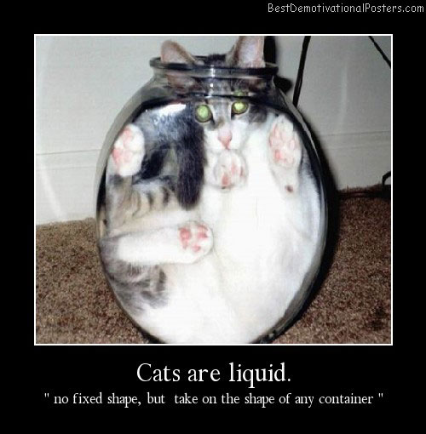

Slide 6

GAS
No definite shape or volume
Can move freely (expand) without any limits

Slide 7
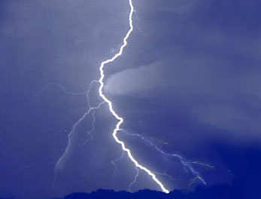
PLASMA
High energy phase
Least common on Earth
Most common phase
in the rest of the
universe

Slide 8
MATTER MOVIE
http://www.abpischools.org.uk/page/modules/solids-liquids-gases/slg2.cfm?coSiteNavigation_allTopic=1

Slide 9
Solid 4. Condensation (Gas becomes a Liquid)
Liquid 5. Freezing (Liquid becomes a Solid)
Gas 6. Melting (Solid becomes a Liquid)
5
4
1
6
7
3
2
8
7. Evaporation (Liquid becomes a Gas)
8. Sublimation (Solid changes instantly to Gas)

Slide 10
Elements Mixtures & Compounds

Slide 11
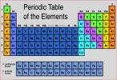
Elements
Substances that can’t be broken down into other substances
Periodic Table
  Elements are listed on a chart in order of their characteristics
Chemical Symbol
  1 or 2 letters that stand for an element
  Usually, but not always an abbreviation of the elements name

Slide 12


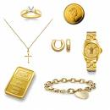

Examples of Chemical Symbols
Oxygen – O Helium – He
Gold – Au Iron - Fe

Slide 13

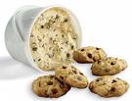
Mixtures
Combination of 2 or more substances in which the substances keep their own properties
NOT chemically combined
NO definite amount of each ingredient
Examples: Milk, Kool-Aid, Pudding, Raisin Bran, Chocolate Chip Cookie Dough

Slide 14
Compounds
2 or more elements that have been chemically combined
Has new properties that are different from the properties of the elements it’s made of (new substance)
Can be broken down by chemical means
Has a definite amount of each element

Slide 15


Compounds
Molecule
  Smallest part of a compound (can’t be any smaller unless it is broken apart into separate elements)
Chemical Formula
  Used to show what elements and how many make up a compound
  Examples: NaCl (sodium chloride) H2O (water)
  Sodium Chlorine 2 Hydrogen Oxygen

Slide 16
Common Elements and Compounds in Earth Science
Hydrogen H Lead Pb
Helium He Radon Rn
Carbon C Uranium U
Nitrogen N Nitrate NO3
Oxygen O Carbon Monoxide CO
Sodium Na Carbon Dioxide CO2
Fluorine F CloroFluoroCarbons CFC’s
Aluminum Al Ozone O3
Silicon Si Water H2O
Sulfur S Methane CH4
Chlorine Cl Ammonia NH3
Calcium Ca Sulfuric Acid H2SO4
Iron Fe Iron Oxide (Rust) FeO
Nickel Ni Calcium Carbonate (Limestone) CaCO3
Magnesium Mg Silicon Dioxide (Quartz) SiO2
Iridium Ir Sodium Chloride (Salt) NaCl

Slide 17
Elements Foldable
Materials
1 Element Foldable
1 Pen/Pencil
Scissors
Colored Pencils: Red, Green, Yellow, Blue

Slide 18
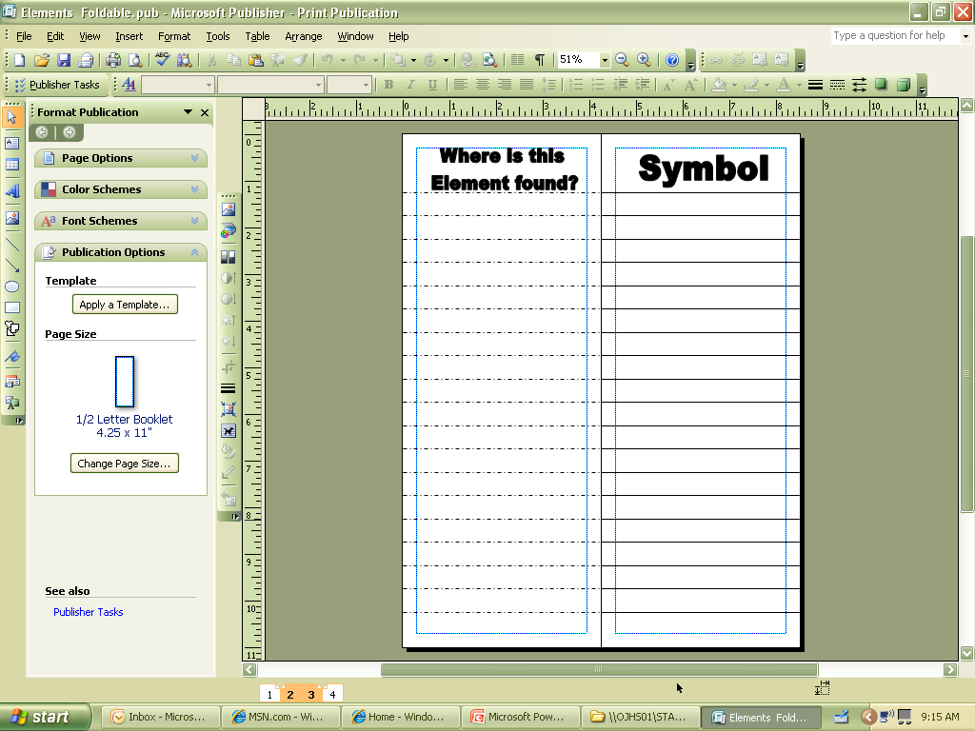
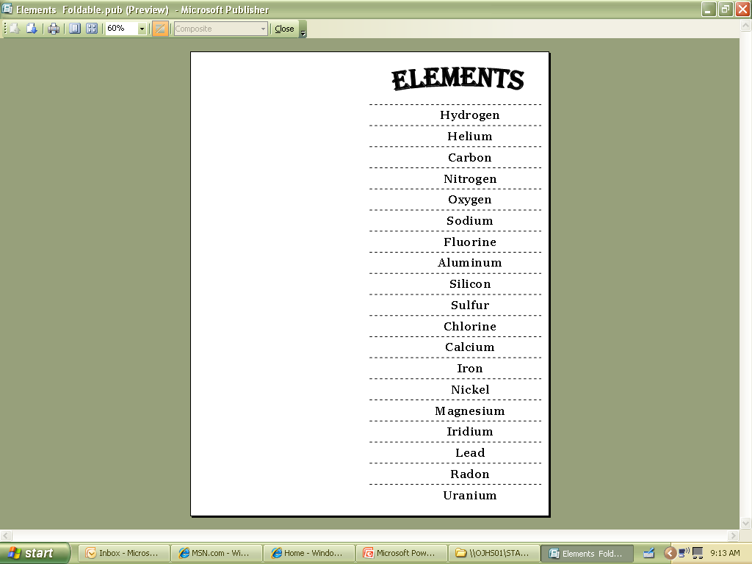
STEP 1
Fold your foldable in ½.
After folding in ½, your foldable should look like this

Slide 19
STEP 2
Open your foldable and cut ONLY on the dotted lines!
DO NOT cut while folded!

Slide 20

STEP 3
Write in the information on the inside of your foldable as the information is shown in the next slides.
Write in the symbol (use
your colored pencils for this
part)
Color Code the front (with
the same color you used for
the element symbol, make a
star or shade in the area
next to the element name)
Write in where the element
is found (this will be shown
in the ‘common example’ or
in the ‘earth science
connection’)
H

Slide 21
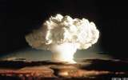
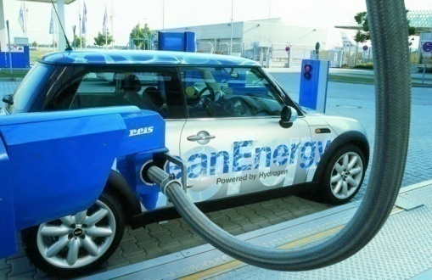

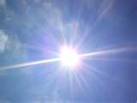
Hydrogen
Common Example
H
Earth Science Connection
Hydrogen (H) Bomb
Hydrogen Fuel
Most Common Element in Stars
Lightest Element

Slide 22
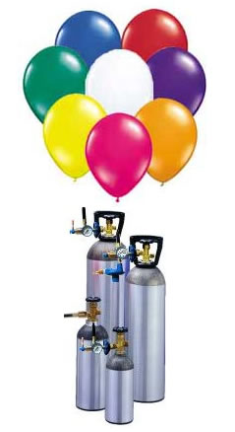
Helium
Common Example
He
Earth Science Connection
Produced in the Sun
Gas for Floating Objects

Slide 23
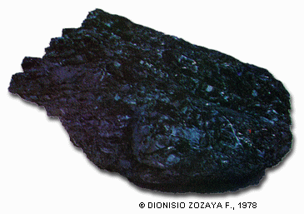
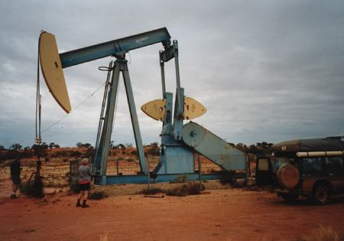
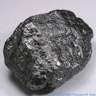

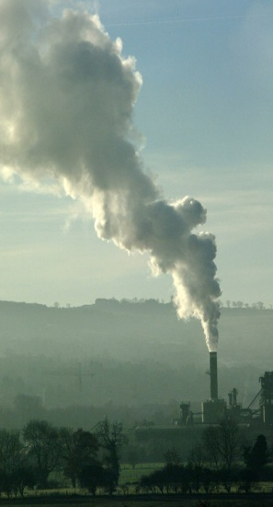
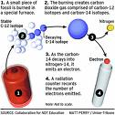
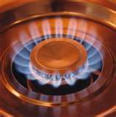
Carbon
Common Example
Earth Science Connection
C
Oil
Coal
Carbon Dating
Natural Gas
Coal Power

Slide 24
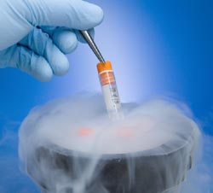
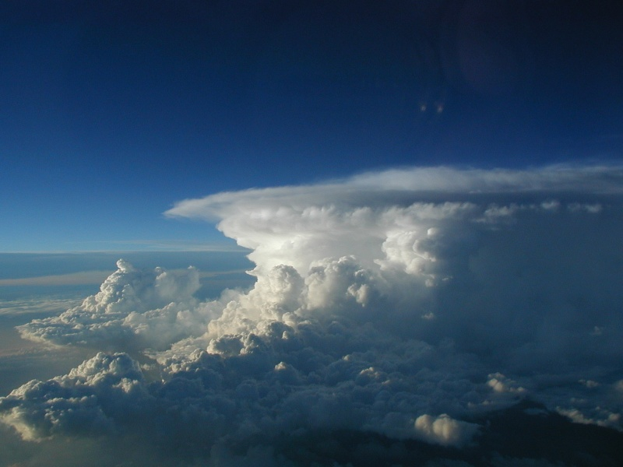
Nitrogen
Common Example
N
Earth Science Connection
Dry Ice
78% of Earth’s Atmosphere

Slide 25
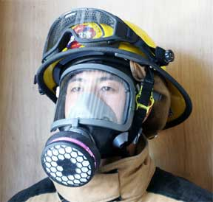
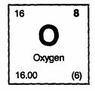
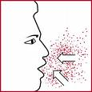

Oxygen
Common Example
Earth Science Connection
O
Gas Used by Humans to Release Energy
21% of Earth’s Atmosphere

Slide 26
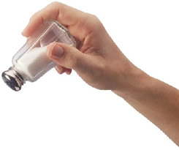
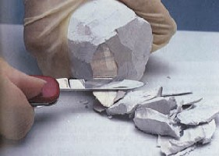
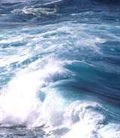
Sodium
(Natrium)
Common Example
Earth Science Connection
Na
6th Most Common Element on Earth
Element in Table Salt (Sodium Chloride)
Part of the Ocean (Salt) Water

Slide 27
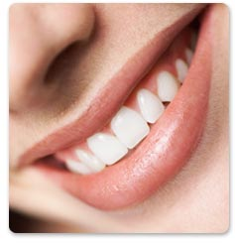
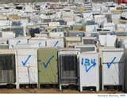
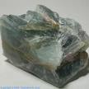

Fluorine
Common Example
F
Earth Science Connection
Part of a Cooling Agent Found in Older Appliances
Used to Strengthen Tooth Enamel
Negatively Affects Our Atmosphere

Slide 28
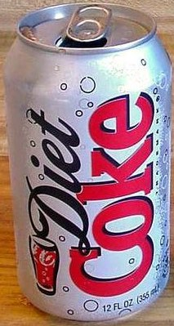
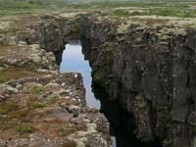

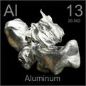
Aluminum
Common Example
Earth Science Connection
Al
One of the Most Common Elements in Earth’s Crust
Used in Thousands of Household Products Like Pop Cans and Sinks

Slide 29
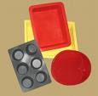

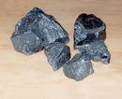


Silicon
Common Example
Earth Science Connection
Si
Most Common Mineral on Earth
Used to Make Thousands of Products Like Kitchen Utensils, WII Remote Covers, Calk and Plastic Bracelets

Slide 30
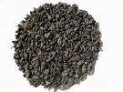
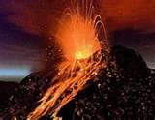


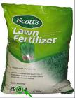
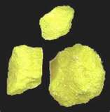
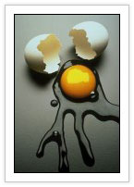
Sulfur
Common Example
Earth Science Connection
S
Released in Volcanic Eruptions and Hot Springs
Found in Many Products Like Matches, Gunpowder and Fertilizer
Rotten Egg Smell
Negatively Affects Our Atmosphere

Slide 31
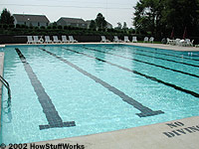
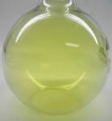
Chlorine
Common Example
Earth Science Connection
Cl
Part of a Cooling Agent Found in Older Appliances
Used to Disinfect Water
Negatively Affects Our Atmosphere
Element in Table Salt (Sodium Chloride)
Part of the Ocean (Salt) Water

Slide 32
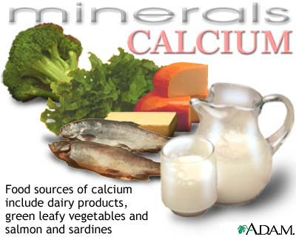
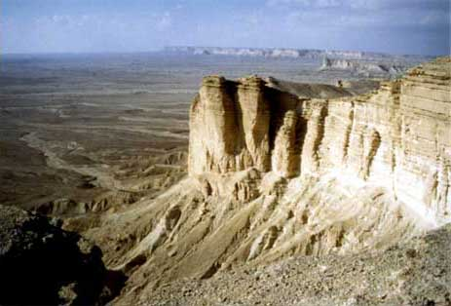
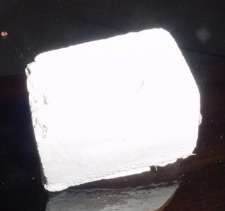
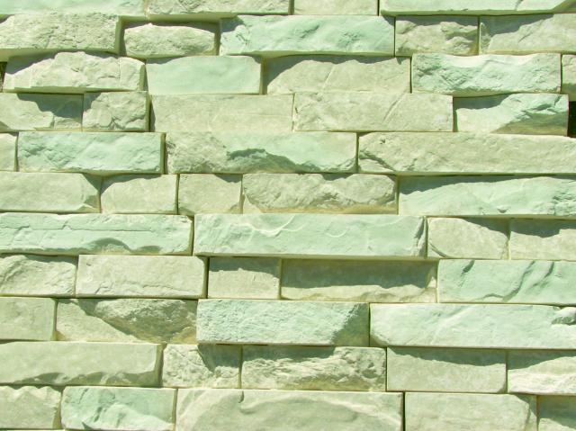
Calcium
Common Example
Earth Science Connection
Ca
Used by Our Bodies to Build Bones and Regulate Heartbeat
Element in Limestone, the Most Common Rock on Earth

Slide 33
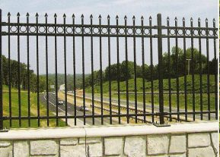
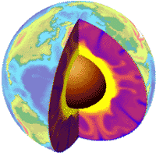
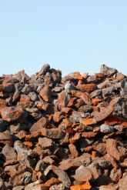
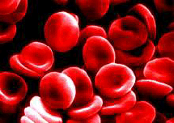
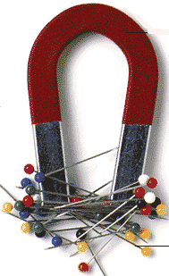
Iron
(Ferrum)
Common Example
Earth Science Connection
Fe
Used in Many Metal Products
Element in the Earth’s Core and Crust
Carries Oxygen Through Our Bodies
Magnetic

Slide 34



Nickel
Common Example
Earth Science Connection
Ni
Used in Many Metal Products
Element in the Earth’s Core
Element in Some Batteries

Slide 35



Magnesium
Common Example
Earth Science Connection
Mg
Used By Our Bodies to Perform Over 300 Reactions in the Body Like Helping With Muscle Contraction
Common Element in the Earth’s Crust
Used in Many Metal Products

Slide 36




Iridium
Common Example
Earth Science Connection
Ir
Used to Strengthen Platinum
Comes From Asteroids and Comets

Slide 37







Lead
(Plumbum)
Common Example
Pb
Earth Science Connection
Protects Against Radiation
Pollutes Water and Poisonous if Ingested
Used in Many Products Like Fishing Lures and Glass

Slide 38



Radon
Common Example
Earth Science Connection
Rn
Sometimes Used for Cancer Radiation Treatments
Given Off Naturally By Bedrock
Dangerous to Animals

Slide 39



Uranium
Common Example
Earth Science Connection
U
Common in Small Amounts in All Rocks
Used to Create Nuclear Power

Slide 40
Compounds Foldable
Materials
1 Compound Foldable
1 Pen/Pencil
Scissors

Slide 41


STEP 1
Fold your foldable in ½.
After folding in ½, your foldable should look like this

Slide 42
STEP 2
Open your foldable and cut ONLY on the dotted lines!
DO NOT cut while folded!

Slide 43
STEP 3
Write in the information on the inside of your foldable as the information is shown in the next slides.
Write in the symbol
Write in where the compound
is found (these possibilities
will be in PINK)

Slide 44
Color Coding
You may be using multiple colors on each compound to color code. Similar to what we used earlier, but you’re looking at the entire name.
- GREEN- Only the FIRST letter is the symbol
- YELLOW- The FIRST TWO letters is the symbol
- RED- The Latin/Greek/Other name is abbreviated.
- BLUE- The FIRST letter and another letter are used.
EXAMPLE:
  Carbon Monoxide- CO
  Color code the SYMBOL ONLY.

Slide 45


Carbon Monoxide
CO
Contains
(1 atom) Oxygen
Mon = 1
Contains Carbon
Colorless, Odorless, Tasteless, but highly toxic!
Found in Automobile Exhaust
Pollutes Our Atmosphere

Slide 46




Ammonia
NH₃
Household Cleaner
Contains Nitrogen
Contains (3 atoms) of Hydrogen
Compound in Animal Waste
Pollutes Rivers and Lakes From Field Runoff, but Plants Need it to Grow

Slide 47




Iron Oxide
FeO
Rust
Contains Iron (Fe)
Contains Oxygen
Common Name is Rust
Compound That Makes Dirt Red in Color

Slide 48

Ozone
O₃
Ozone Layer in the Atmosphere Protects Us From Ultraviolet (UV) Radiation
Contains (3 atoms) of Oxygen
Given Off By Car Exhaust and a Pollutant at Ground Level

Slide 49



Carbon Dioxide
Exhaled by Animals
CO₂
Given Off by the Burning of Fossil Fuels
Contains Carbon
Contains (2 atoms) of Oxygen
Di = 2
Plants Use CO₂
Too Much in the Atmosphere Causes Climate Change

Slide 50


Silicon Dioxide
SiO₂
Contains Silicon
Contains (2 atoms) of Oxygen
Di = 2
Common Name is Quartz
Quartz: Most Common Mineral on Earth

Slide 51


Nitrate
NO₃
Pollutant Found in Animal Waste
Contains Nitrogen
Contains (3 atoms) of Oxygen
Pollutes Lakes and Rivers

Slide 52


Water
H₂O
Compound Needed by All Life
Contains (2 atoms) of Hydrogen
Contains Oxygen
Makes Up 75% of the Earth’s Surface

Slide 53



Sulfuric Acid
H₂SO₄
Enters Our Atmosphere Through Automobiles and Factories
Contains (2 atoms) of Hydrogen
Contains Sulfur
Contains (4 atoms) of Oxygen
Falls Back to Earth as Acid Rain

Slide 54


Chlorofluorocarbons
CFC’s
Used in the 1950’s-1990’s as a coolant and to make products such as styrofoam
Destroys the earth’s Ozone layer

Slide 55




Calcium Carbonate
CaCO₃
Contains Calcium
Contains Carbon
Contains (3 atoms) Oxygen
Common Name is Limestone

Slide 56

Methane
CH₄
Too Much Pollutes the Atmosphere
Contains Carbon
Contains (4 atoms)
Hydrogen
Natural Gas Given Off by the Earth and Animals

Slide 57




Sodium Chloride
NaCl
Contains Sodium (Na)
Contains Chlorine
Common Name is Table Salt

