Slide 1
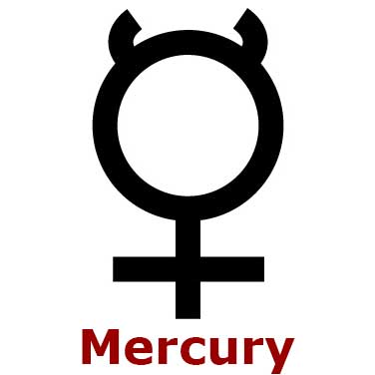
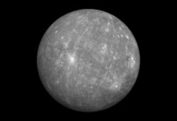
Mercury planet project
By Wendell r. , derek d. ,griffin f. ,chase v.

Slide 2
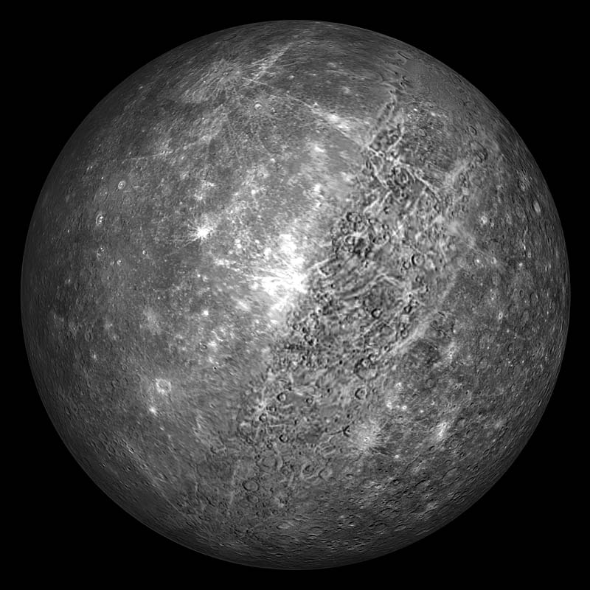
What does the planet look like?
The Planet is Gray. It Is Round. It has lots of Craters. This is what it looks like ===>

Slide 3
HAVE WE EXPLORED IT?
We have explored mercury on three different occasions in 1974, 1975, and 2004 since then we have mapped over half of the planet

Slide 4
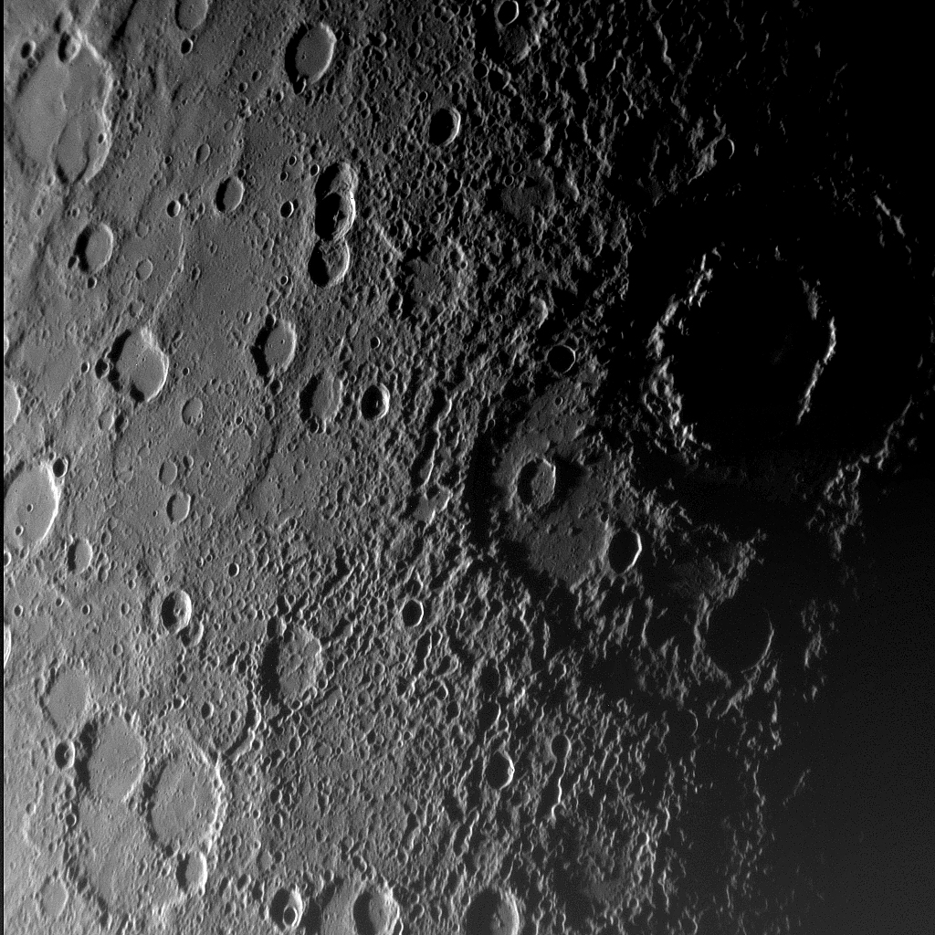
Features on mercury?
Mercury is a very cratered
Mercury has lots of ridges
It has a molten core

Slide 5
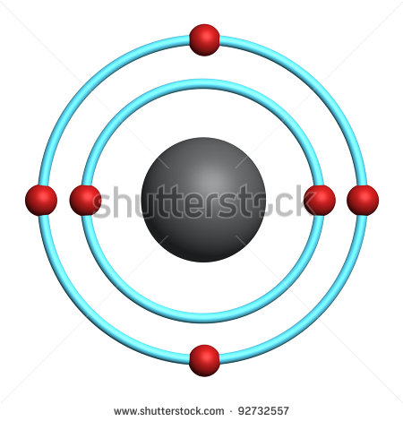
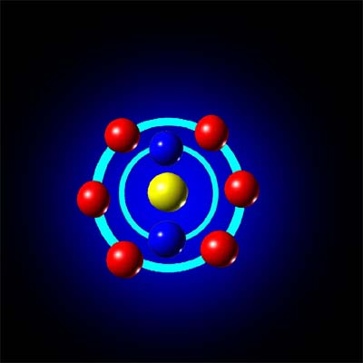
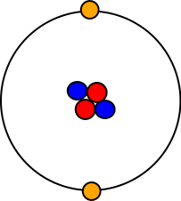
Atmosphere in mercury?
The atmosphere of mercury is made up of hydrogen, helium, oxygen, sodium, calcium, potassium and water vapor.
Some of the gasses present are oxygen, helium, and carbon dioxide.
But the atmosphere keeps on getting away because the planet does not have a gravity pull big enough to keep the atmosphere, but the atmosphere is replenished.

Slide 6
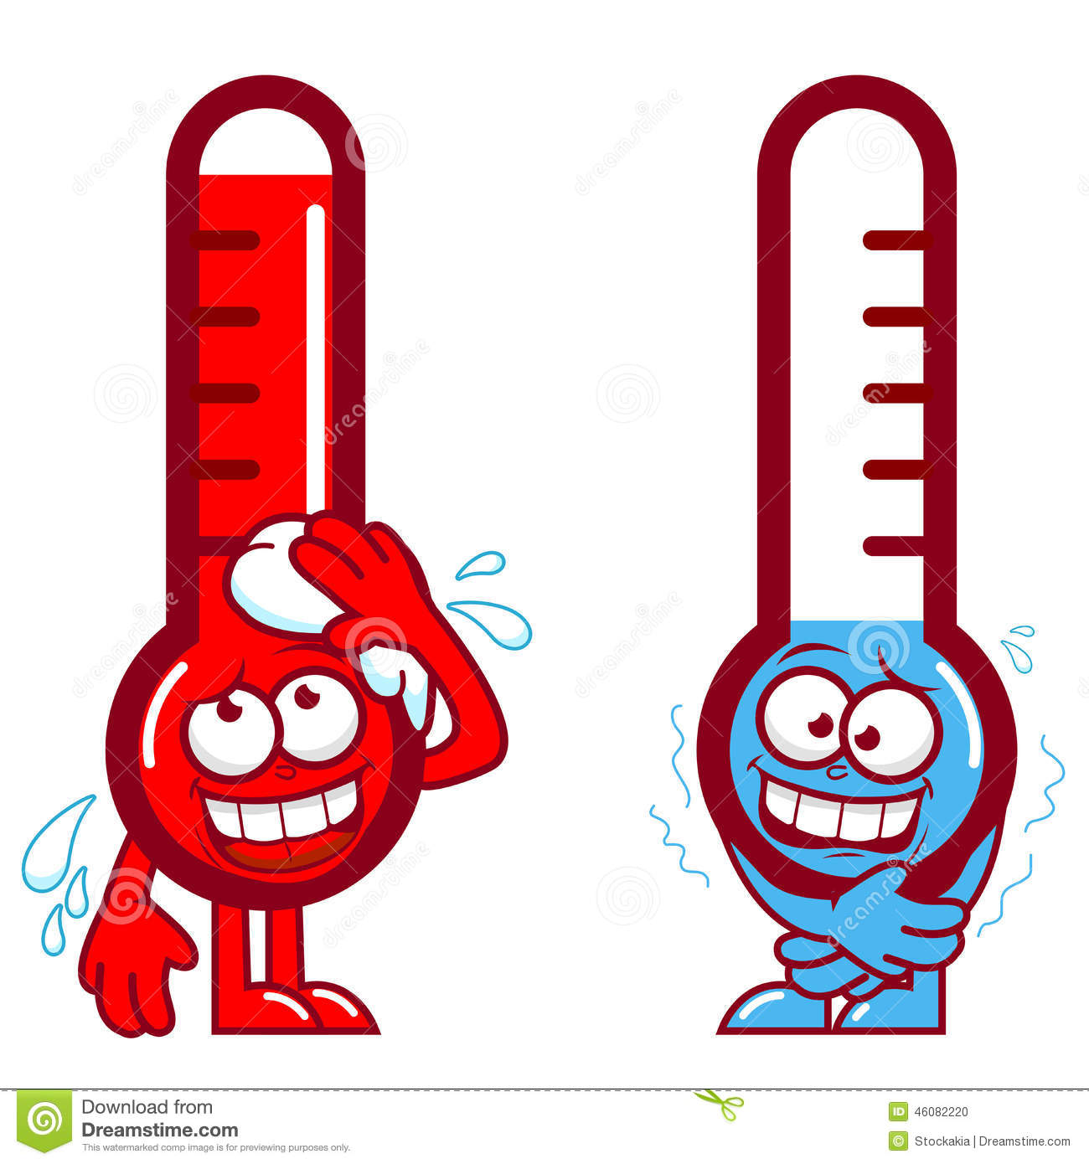
What is the average temperature? High Temperature? Low temperature?
During the day, Mercury is 427 degrees Celsius (801 degrees Fahrenheit).
At Night it is –173 degrees Celsius (-279 degrees Fahrenheit).
The Average Temperature on Mercury is 167 degrees Celsius (332 degrees Fahrenheit).

Slide 7
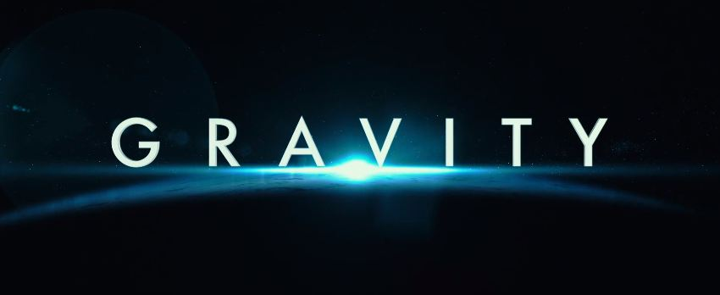
Gravity ?
-You weight 38 percent less on mercury then on earth.
-if a man weighed 180 lbs he would weight 68.4 on mercury
-the same man could jump twice as high on mercury

Slide 8
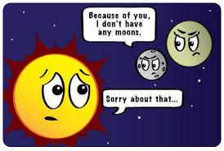
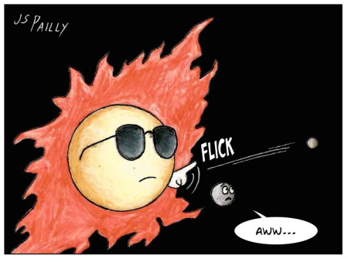
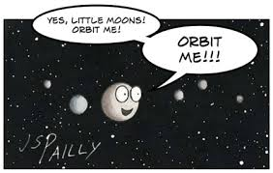
Mercury's moons
It has none

Slide 9
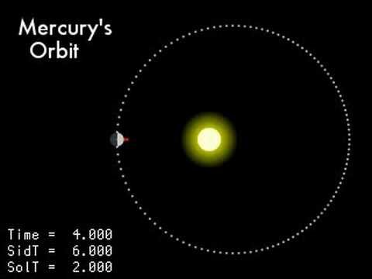
How Long is The revolution/orbit?
It takes about 88 Earth Days for Mercury complete one revolution around the sun.
The Length of Day on Mercury (Sunrise to Sunrise) is 176 Earth Days.

Slide 10
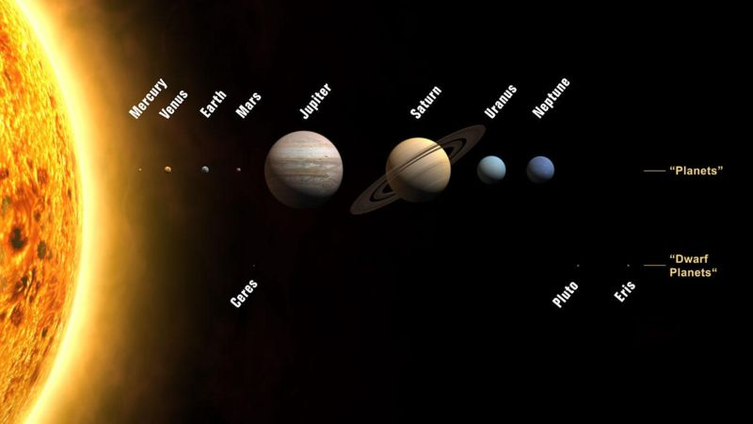
Mercury's Distance from sun?
The current distance from mercury to the sun is 43.3 million miles (69.8 million km./ 0.46au)

Slide 11
How long is spin or rotation?
- its spins at 10 km/h
It rotate every 58 days
One day is 1400 hours

Slide 12
How big is mercury?
Mercury's diameter is 4879 km
Mercury's mass is 3.285 × 10^23 kg
Mercury's density is 5.43 g/cm³

Slide 13
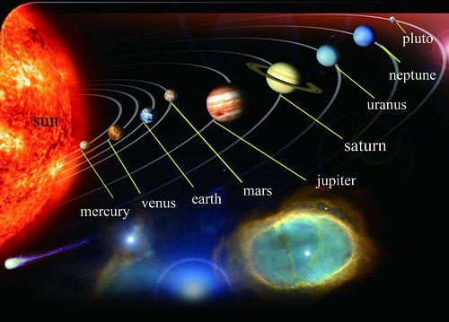
3 other interesting things about mercury
Did you know that Mercury is the closest planet from the sun?
Did you also know that mercury is the second hottest planet with 840 degrees Fahrenheit?
Did you know that mercury is the smallest planet in our solar system?

