Slide 1
Unit Central Question
Why are some places on Earth hotter than others at different times of the year?

Slide 2
Lesson 1: Focus Question
What patterns in temperature can you find on Earth at different times of the year?

Slide 3
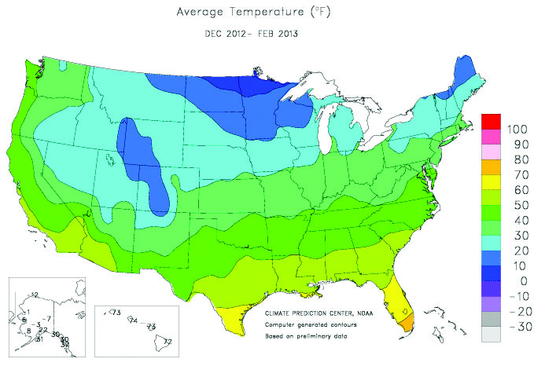
What patterns in temperature do you observe in the United States?

Slide 4
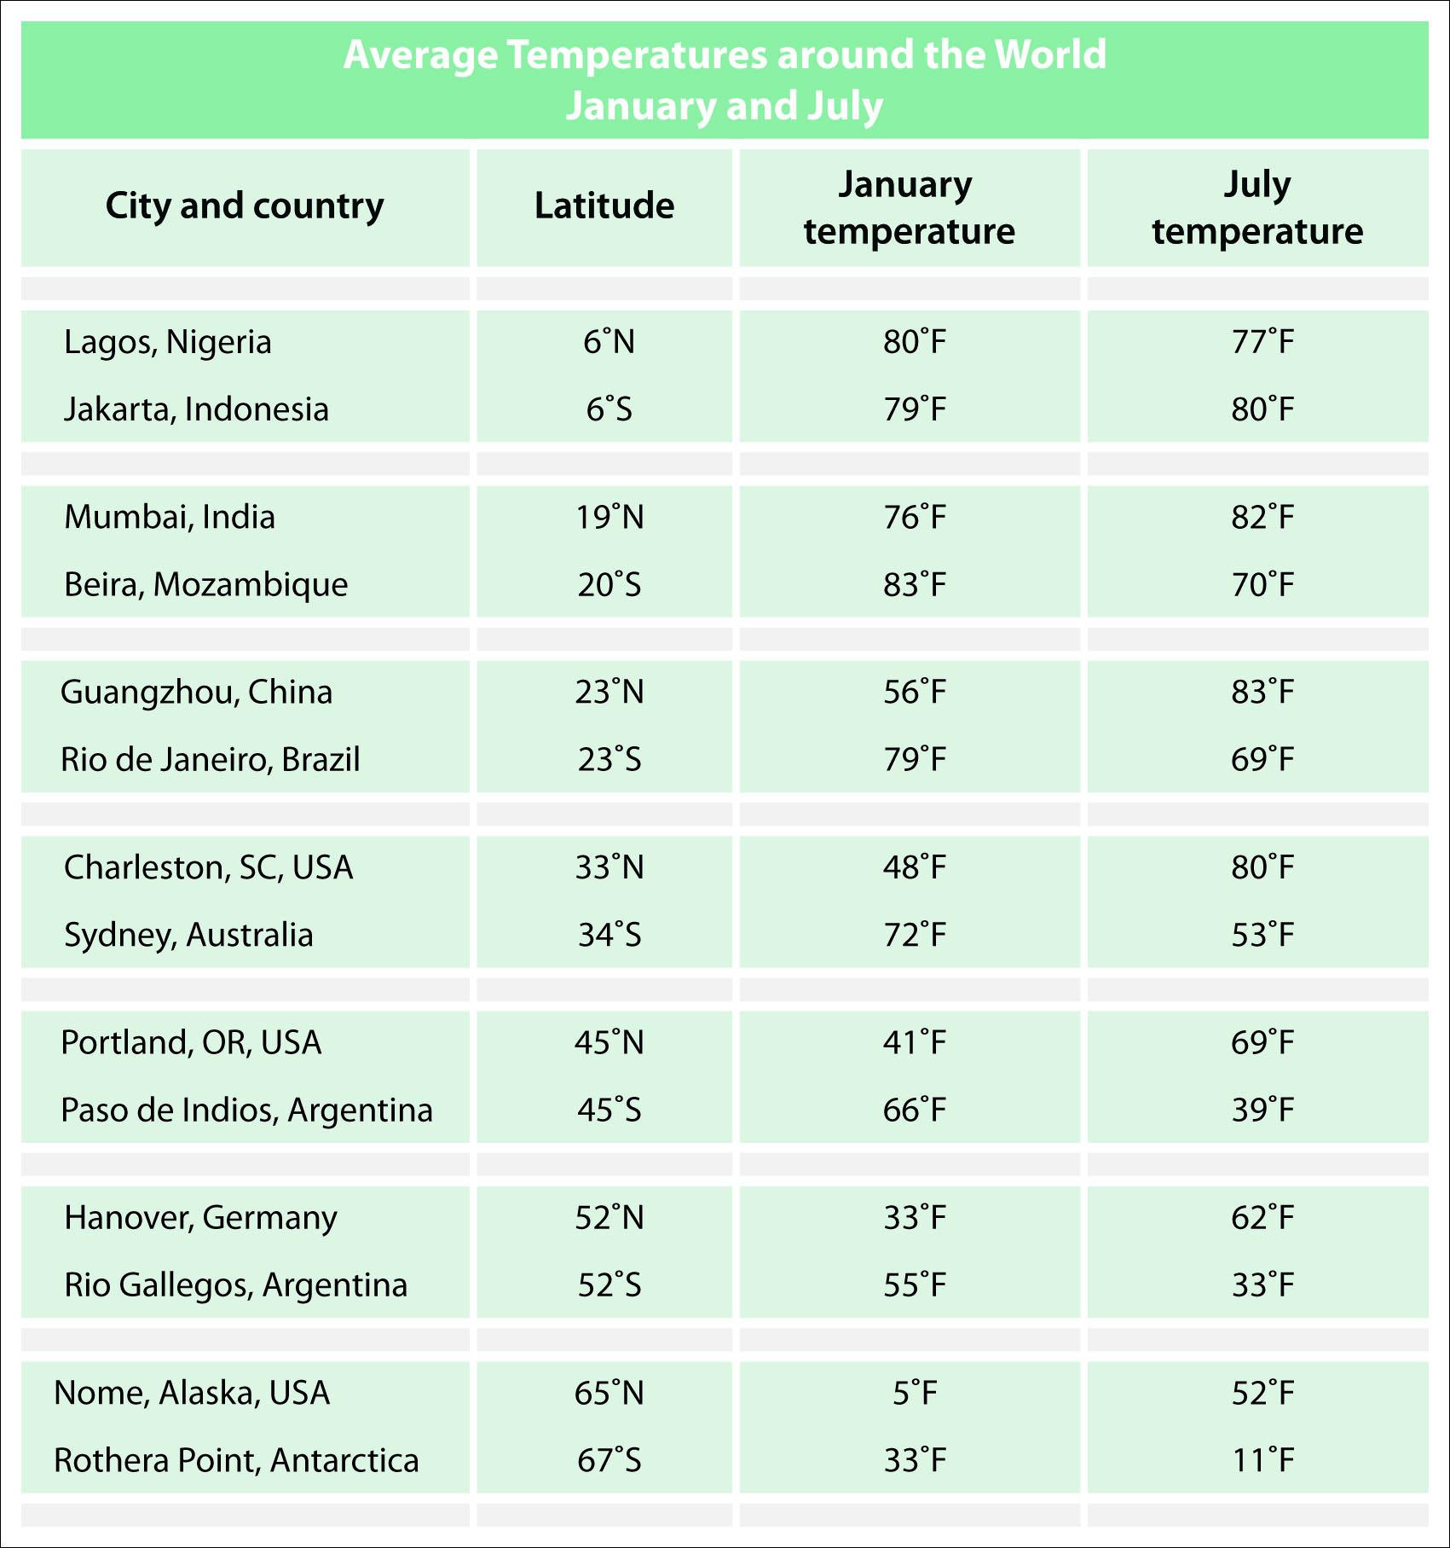
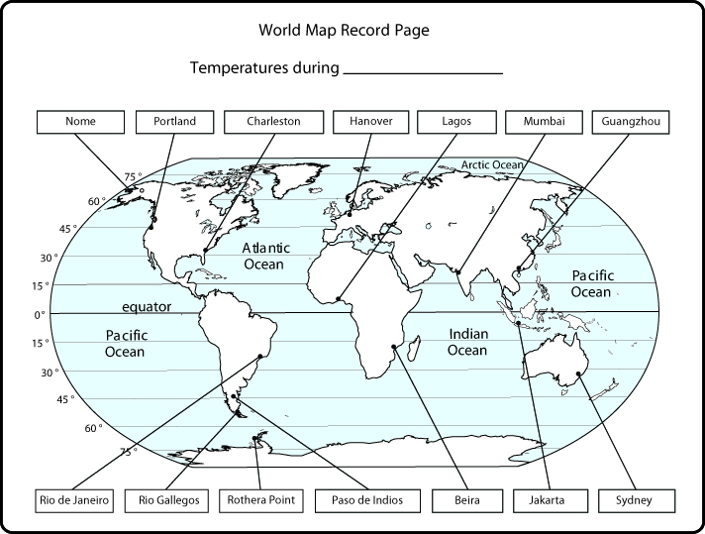
Investigation: What patterns in temperature can you find on Earth at different times of the year?
Notes:
Can you fit enough of both images on this slide so the teacher can use the slide to help the kids figure out how they use the data from the data table to complete the World Map Record Page? The slide does not have to show the complete image of both, just enough so kids get the idea of how the two pages relate to each other.
If this doesn’t work, then you can put each image on a separate slide.

Slide 5
Investigation: What patterns in temperature can you find on Earth at different times of the year?
With your partner, record on the World Map Record Page the temperature for each city.
Make sure you write temperatures for January on the map labeled January and temperatures for July on the map labeled July.
Notice the latitude of each city as you add the temperature.

Slide 6
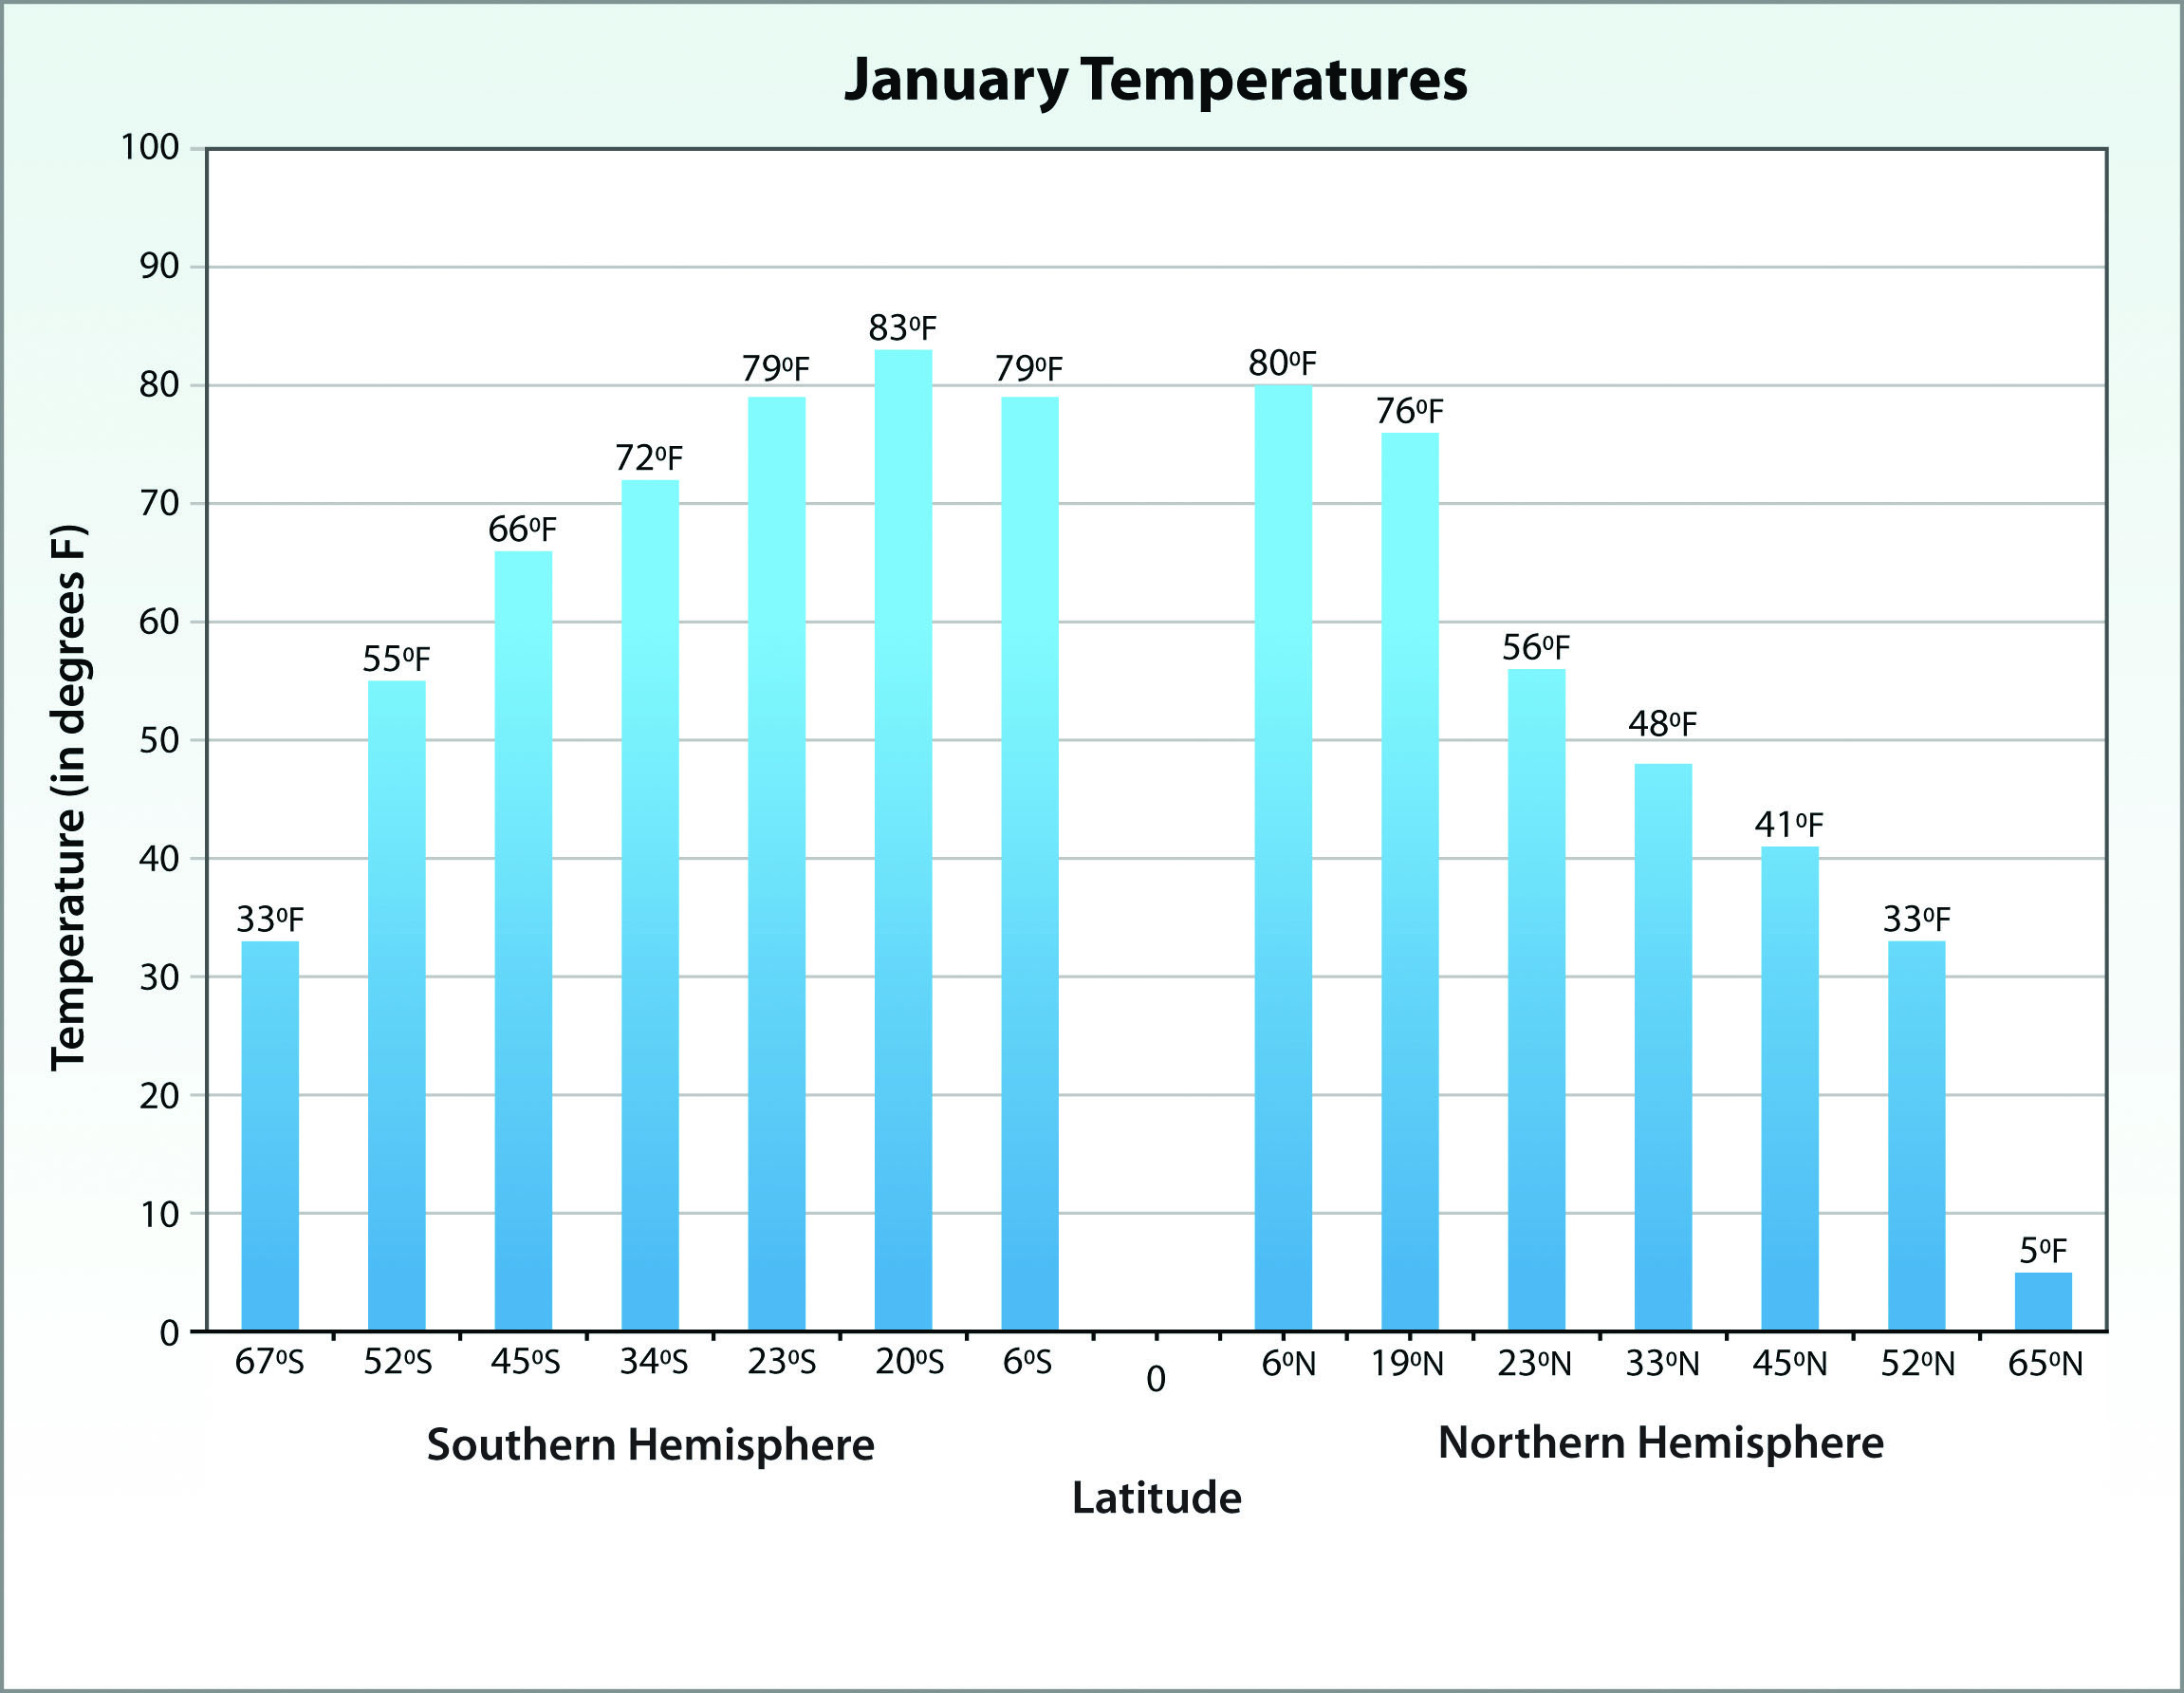
Investigation: What patterns in temperature can you find on Earth at different times of the year?
Mark the equator on your maps.
The equator is at what degree of latitude?
Where do you see the latitude of the equator on this bar graph?

Slide 7
Investigation: What patterns in temperature can you find on Earth at different times of the year?
Let’s make sense of our bar graphs.
What do the bars represent?
What labels are on the x and y axes?
How do the bars relate to the temperatures you wrote on the World Map Record Pages?

Slide 8
Investigation: What patterns in temperature can you find on Earth at different times of the year?
What patterns do you observe on the bar graphs of January and July temperatures?
Write the patterns in your science notebook.
Can you find patterns related to the month of the year—January versus July?
Can you identify patterns related to the Northern and Southern Hemispheres?
Use all of your data sources to look for patterns.

Slide 9
Investigation Summary: What patterns in temperature can you find on Earth at different times of the year?
Let’s share our ideas.
Team 1: Give us one pattern you noticed related to latitude and temperature at various places on Earth.
I agree/disagree with Team 1 because __________________________________.
I would like to add to Team 1’s answer.

Slide 10
Investigation Summary: What patterns in temperature can you find on Earth at different times of the year?
Did you notice these patterns?
What happens to the temperature if a city’s location is closer to the equator?
What happens to the temperature if a city’s location is farther away from the equator?
How do temperatures differ in January and July?
Are those patterns the same in the Northern and Southern Hemispheres?

Slide 11
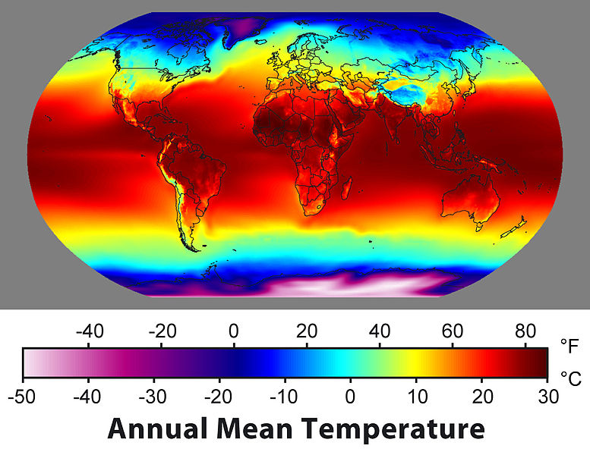
Lesson Summary: Key Science Ideas
What patterns do you observe?
[Image created by Robert A. Rohde / Global Warming Art]

Slide 12
Lesson Summary: Key Science Ideas
Temperatures on Earth are generally warmer in locations closer to the equator.
Temperatures decrease as the latitude increases—as we move away from the equator either north or south.
Summer (hotter time of year) and winter (cooler time of year) are opposite in the northern and southern hemispheres.

Slide 13
In the next lesson, you will think about …
Why are temperatures higher as we get closer to the equator and lower as we move away from the equator?

