Slide 1
Lesson 2: ENERGY ANGLES
Sun’s Effect on Climate
Lesson 2: ENERGY ANGLES
Sun’s Effect on Climate

Slide 2
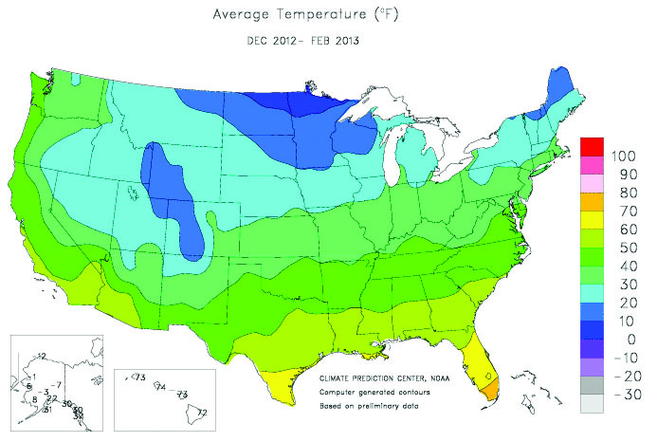
Link to last lesson
What were some patterns we noticed in the temperature maps from yesterday?

Slide 3
Lesson 2: Focus Question
Why are places closer to Earth’s equator hotter than places farther away from the equator?

Slide 4
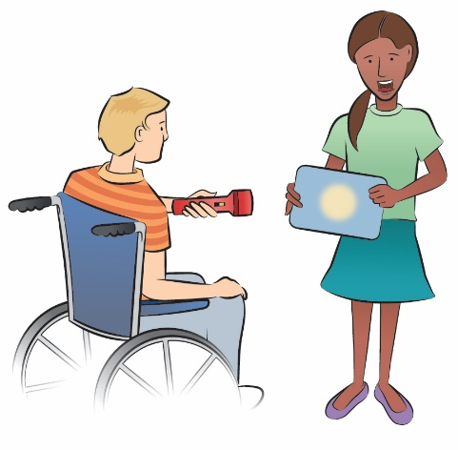
Investigation 1: Angles
Today we will conduct an investigation to learn about angles of sunlight and Earth’s surface.
We will use trays, graph paper, and flashlights.

Slide 5
Investigation 1: Angles
Before we begin, what shape do you think the flashlight will make on the graph paper if the light shines straight at the tray?
Will it change if you tilt the tray?
I predict the light will / won’t change because I think ______________________.

Slide 6
Investigation 1: Energy Angles Data Table
Group # | Direct (straight-on) | Less direct (at an angle)
1
2
3
4
5
6
7
8
9
10
Record the number of lighted squares.

Slide 7
Investigation 1: Energy Angles
Let’s think about:
When is light energy more concentrated—when it shines “straight on” or “at an angle”? What is your evidence?
When is light more spread out – when it shines “straight on” or “at an angle? What is your evidence?

Slide 8
Investigation 1: Energy Angles
Can what we learned with the flashlights and trays help us to answer our focus question:
Why are places closer to Earth’s equator hotter than places farther away from the equator?

Slide 9
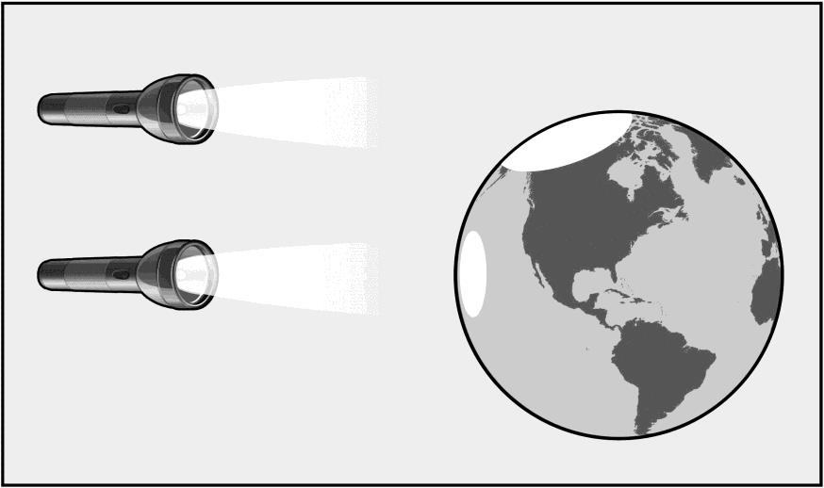
Investigation 1: Energy Angles and Earth
Now, let’s try it with our inflatable globe and flashlights. Think about these questions:
1. What images of light do you see on the surface of the globe?
2. Where is the light most concentrated?
3. Where is the light more spread out?

Slide 10
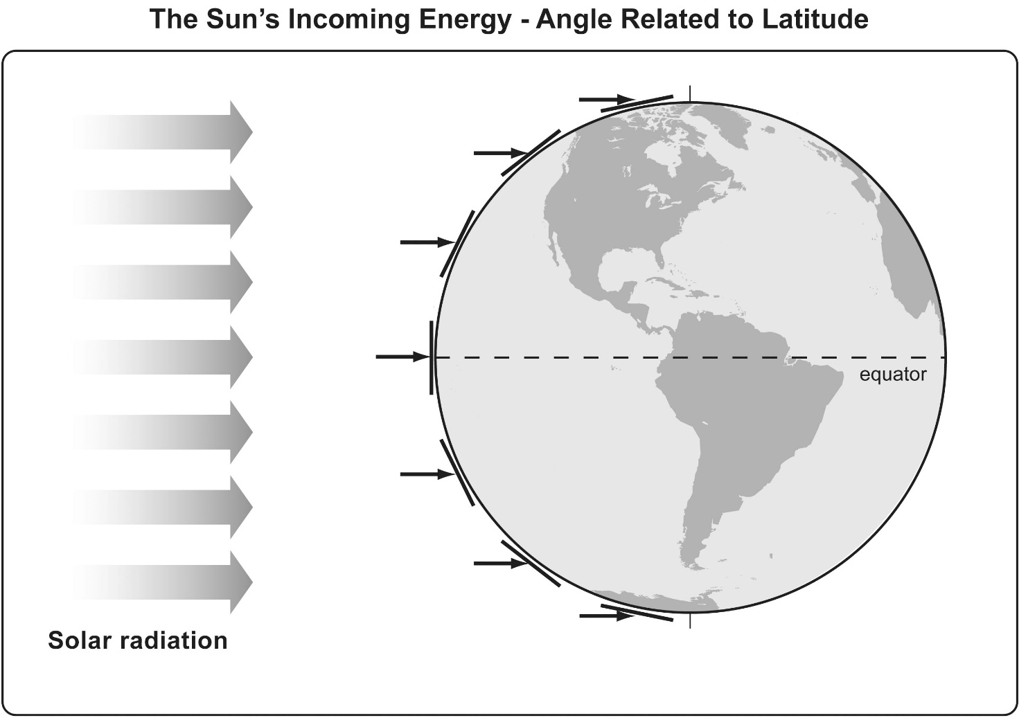
Investigation 1: Energy Angles?
How does our model relate to sunlight and Earth?

Slide 11
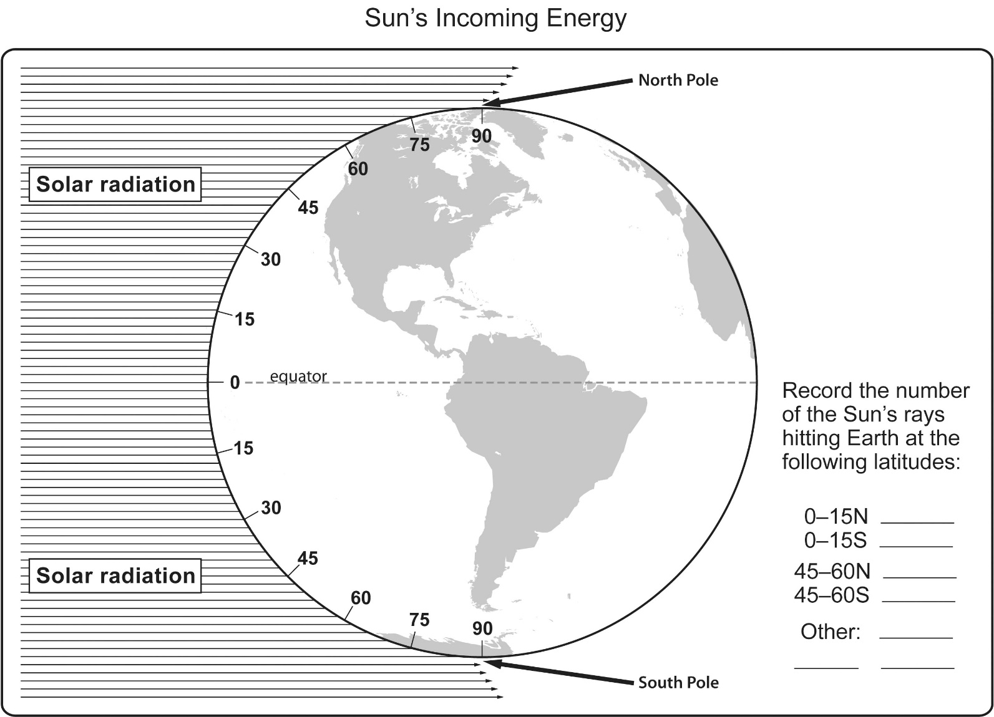
Investigation 2: Concentration of Solar Radiation
[Art adapted with permission from Dr. Lawrence Woolf, General Atomics Sciences Education Foundation]

Slide 12
Investigation 2: Concentration of Solar Radiation
Now that you have counted the rays, let’s discuss:
Can we really “count” rays from the Sun?

Slide 13
Investigation 2: Concentration of Solar Radiation
Did you find any patterns in your data?
Where is the Sun’s light energy more concentrated? What is your evidence?
Where is the Sun’s energy more spread out? What is your evidence?

Slide 14
Lesson Summary: Focus Question
Let’s revisit today’s Lesson Focus Question:
Why are places closer to Earth’s equator hotter than places farther away from the equator?

Slide 15
Lesson Summary: Key Science Ideas
We focused on the angle of the Sun’s light.
We used our data to explain that when the angle of sunlight is direct, the sunlight is more intense (concentrated) and Earth’s surface will get warmer.
When sunlight strikes Earth’s surface at an angle, then the Sun’s light is less concentrated (more spread out) and the surface does not warm as much.

Slide 16
In the next lesson, you will think about …
Why are temperatures different in the Northern and Southern Hemispheres at different times of year?

