Slide 1
Lesson 4: Earth’s tilt and orbit and the reason for the seasons
Sun’s Effect on Climate

Slide 2
Link to last lessons: The Sun’s effect on climate
What patterns did we observe on the bar graphs from Lesson 1?
What important science ideas have we learned from our lessons so far?
(State the science ideas in complete sentences.)

Slide 3
Link to last lessons: The Sun’s effect on climate
From Lesson 2, how does the angle of sunlight affect temperatures on Earth?
How did our model in Lesson 3 of Earth’s orbit around the Sun help us understand seasons?

Slide 4
Lesson 4: Focus Question
Why is it warmer in the summer than in the winter?

Slide 5
Investigation: Why is it warmer in the summer than in the winter?
Let’s use our model to remind ourselves of Earth’s orbit around the Sun.
What is important about the four positions in the orbit?
Do you agree/disagree with this team’s model of Earth’s orbit?
What would you like to add or change to make the model more scientifically accurate?

Slide 6
Investigation: Why is it warmer in the summer than in the winter?
Observe the position of Earth in our handout from Lesson 2.
Is it [the same as/different from] the position in our model of Earth’s orbit?
What is different?

Slide 7
Investigation: Why is it warmer in the summer than in the winter?
Something to think about …
I think adding Earth’s tilt [will change/will not change] where the Sun’s light strikes Earth more directly or at an angle.
My evidence is _____________________.

Slide 8
Investigation: Why is it warmer in the summer than in the winter?
Let’s review today’s investigation.
Angle of Sunlight and Seasons on Earth
Purpose: This activity will help us collect evidence to answer our focus question:
Why is it warmer in the summer than in the winter?

Slide 9
Investigation: Why is it warmer in the summer than in the winter?
Team Task: As Earth orbits the Sun, describe what happens to the angle of sunlight hitting Earth at different times of the year.
Focus your attention on the effect of Earth’s orbit and tilt of the axis. Be prepared to share your ideas.

Slide 10
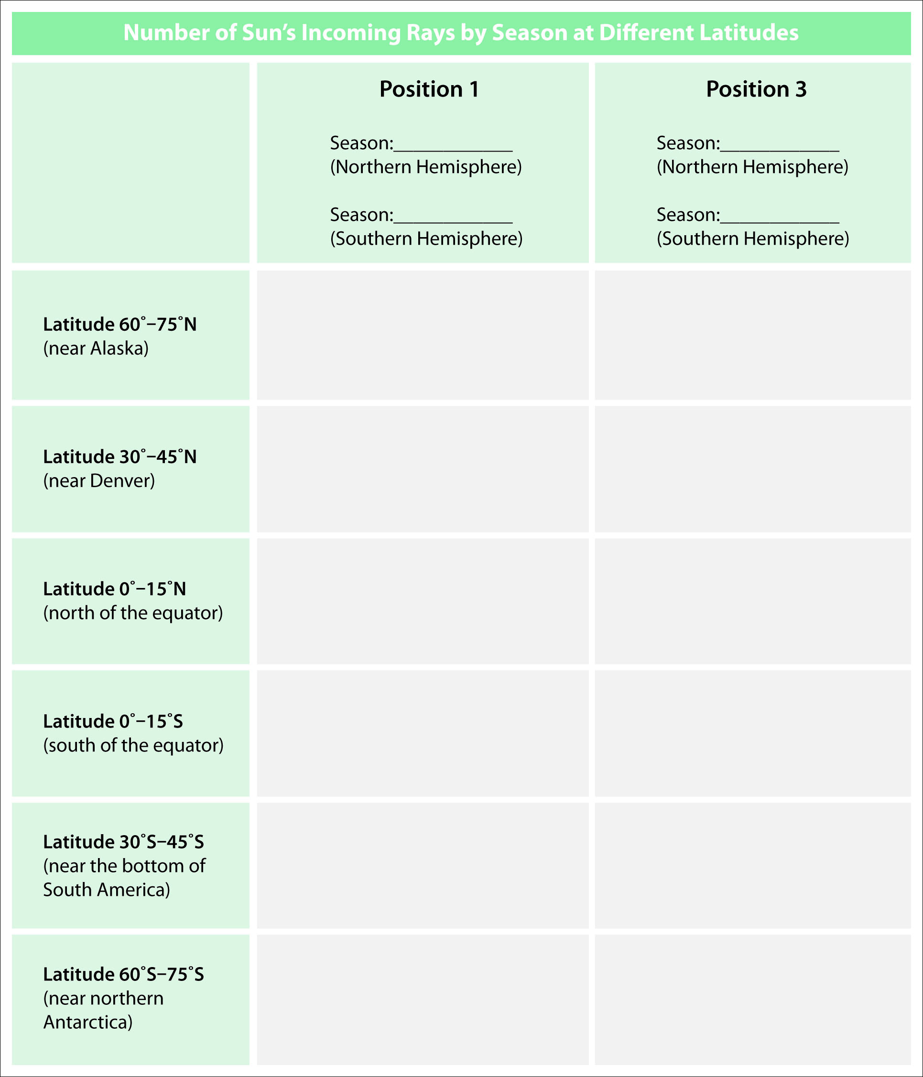
Investigation: Why is it warmer in the summer than in the winter?
Record your data.

Slide 11
Investigation: Why is it warmer in the summer than in the winter?
Set up your model of Earth’s orbit and start collecting your data to answer our lesson focus question.
I will provide additional handouts as each team is ready.
As you complete your data table, record your data on chart paper so we can easily compare our class data. (Write in LARGE numbers!)

Slide 12
Investigation: Why is it warmer in the summer than in the winter?
Where was the Sun’s light more concentrated (more direct)?
In Position 1?
In Position 3?
Think about the squares of graph paper from Lesson 2. Where on Earth’s surface would the light be
more concentrated?
more spread out?

Slide 13
Investigation: Why is it warmer in the summer than in the winter?
As Earth orbits the Sun, does the distance between the Sun and Earth ever change?
If it’s not the distance between Earth and the Sun that changes how warm we are in different seasons, then what does make the difference?

Slide 14
Investigation: Why is it warmer in the summer than in the winter?
Let’s compare our current data with our data from Lesson 2.
How do the numbers of the Sun’s rays compare with and without a tilted Earth at
0°–15° N latitude?
30°–45° S latitude?
60°–75° N latitude?

Slide 15
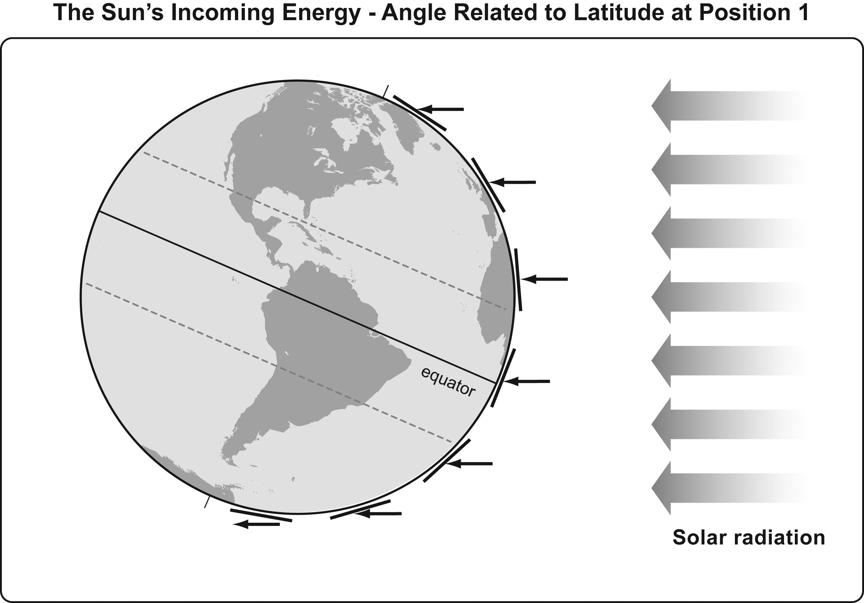
Investigation: Why is it warmer in the summer than in the winter?

Slide 16
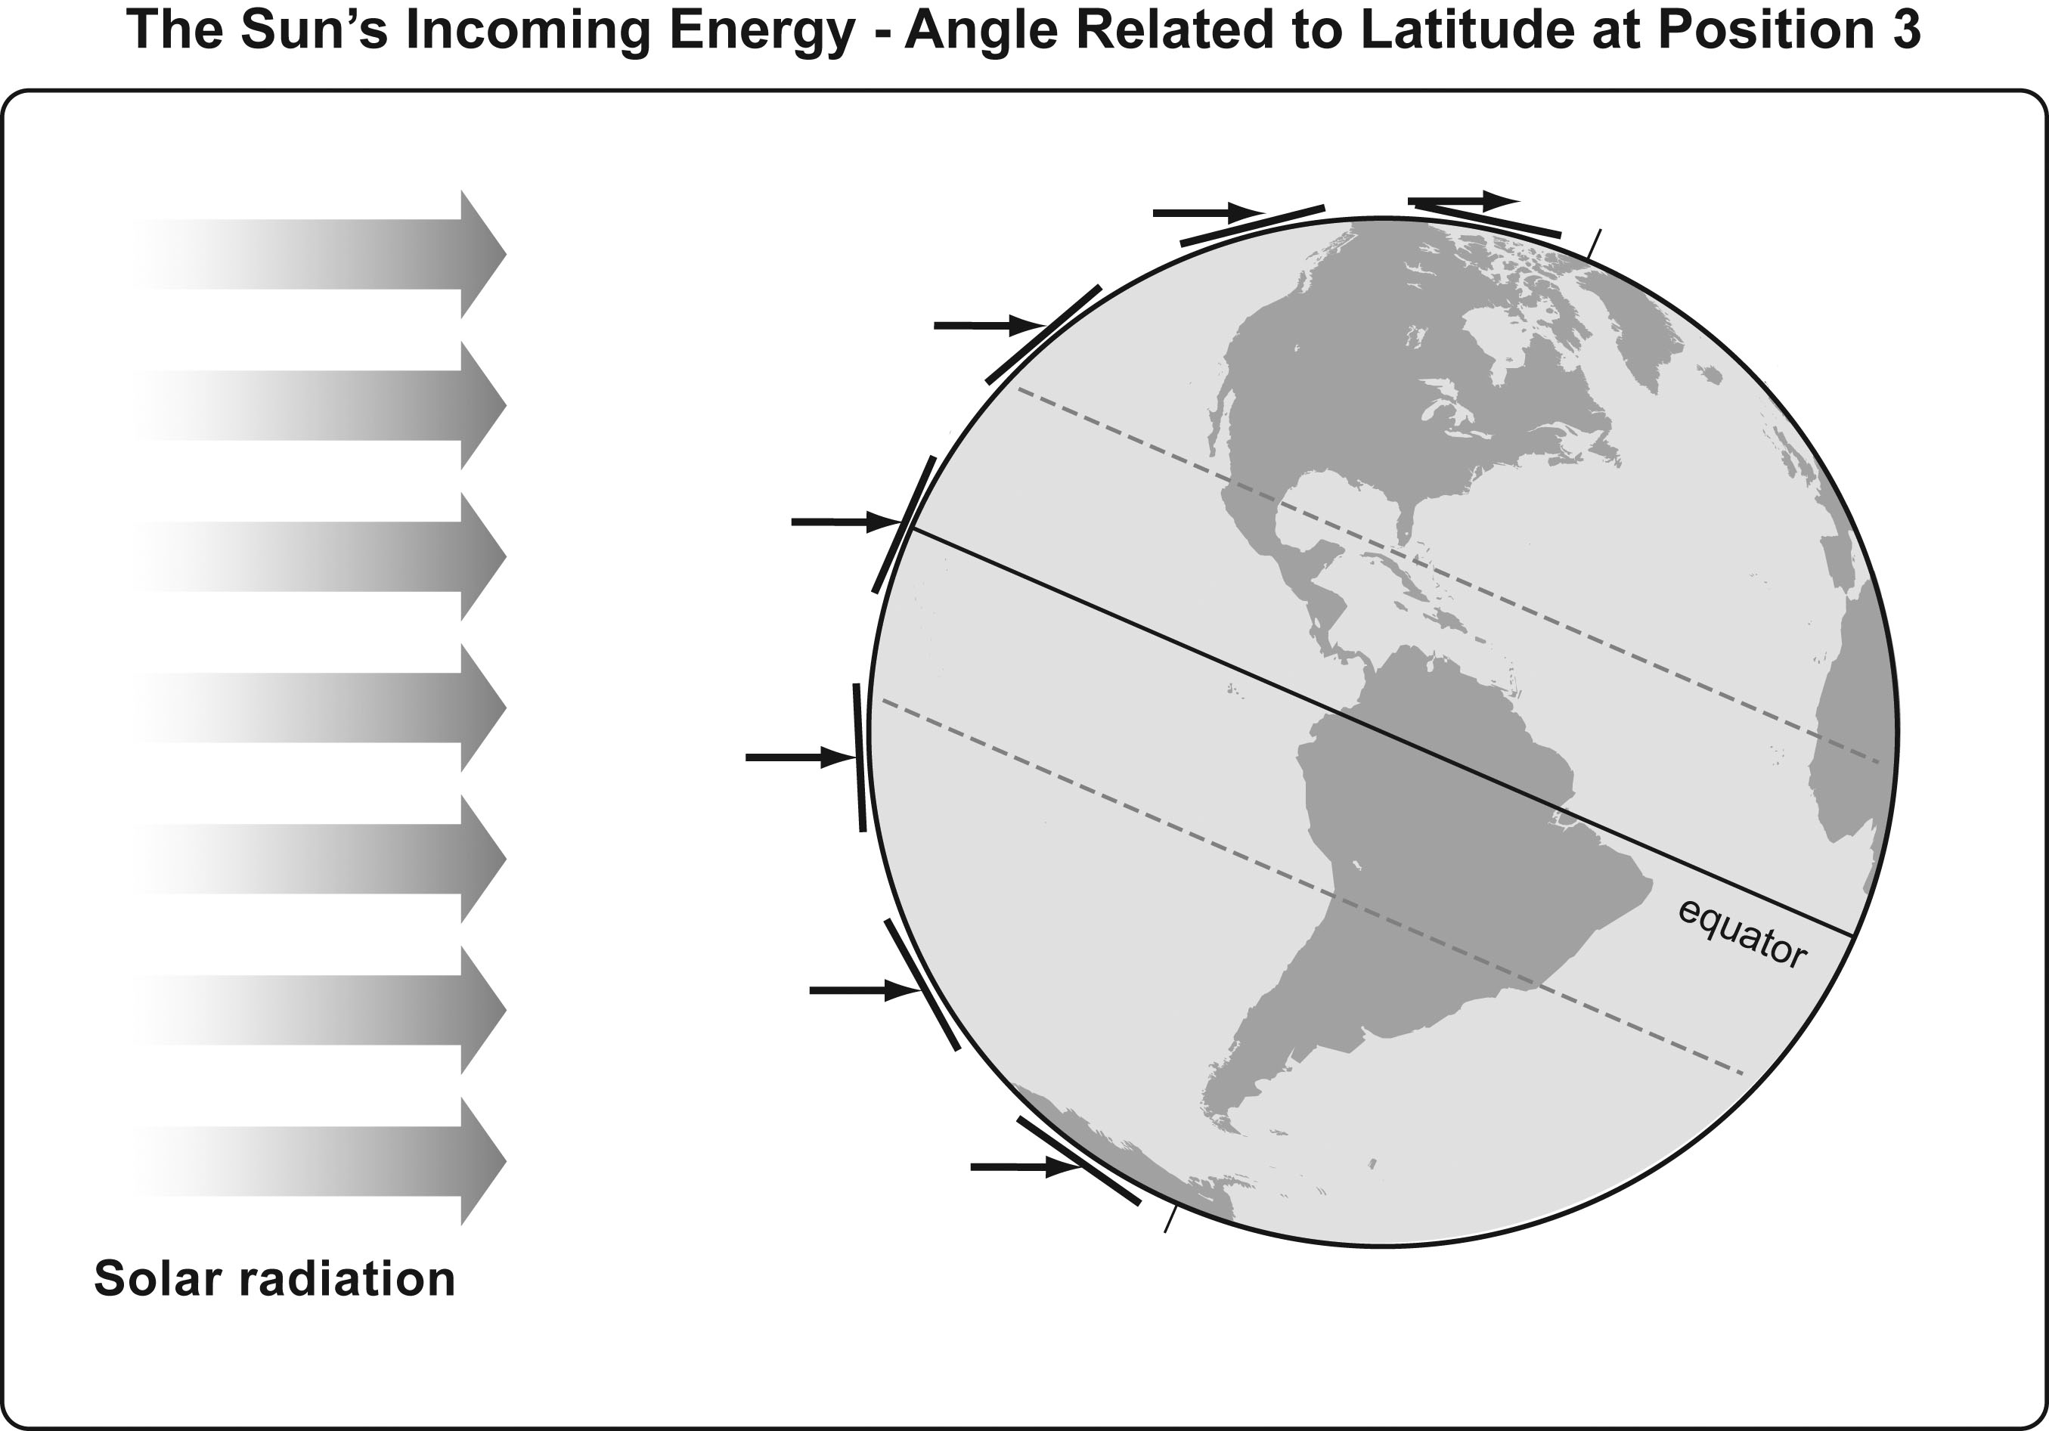
Investigation: Why is it warmer in the summer than in the winter?

Slide 17
Lesson Summary: Key Science Ideas and Today’s Focus Question
When the angle of sunlight is more direct, the sunlight is more intense and Earth’s surface will get warmer.
When sunlight striking Earth’s surface is less direct, then the Sun’s light is less concentrated and the surface does not warm as much.
Based on today’s investigation, use these key science ideas to answer today’s FQ.

Slide 18
Lesson Summary: Key Science Ideas
We experience summer in June, July, and August in the Northern Hemisphere because Earth’s tilt gives us more-direct light at northern latitudes than during the other months of the year.
People in the Southern Hemisphere experience summer in December, January, and February because the Sun’s light is more direct in the southern latitudes when the South Pole points toward the Sun.

Slide 19
Lesson Summary: Key Science Ideas
The angle of sunlight related to Earth’s tilt is one critical factor in determining temperatures around the globe.

Slide 20
In the next lesson, you will think about …
Is there anything other than latitude that influences Earth’s climate?

