Slide 1
Lesson 5: More than latitude
Sun’s Effect on Climate

Slide 2
Link to last lesson
Talk with your teammates about our Unit Central Question.
I think some places on Earth are hotter than others at different times of the year because _________________________.
My evidence from our previous lessons is ________________________________.

Slide 3
Lesson 5: Focus Question
Why do some places at the same latitude have different temperature patterns?

Slide 4
Lesson Focus Question: What are your ideas?
Are there other things besides the angle of sunlight that might explain why some places at the same latitude have different temperature patterns?
Write some possibilities in your science notebook.
Be prepared to share your ideas.

Slide 5
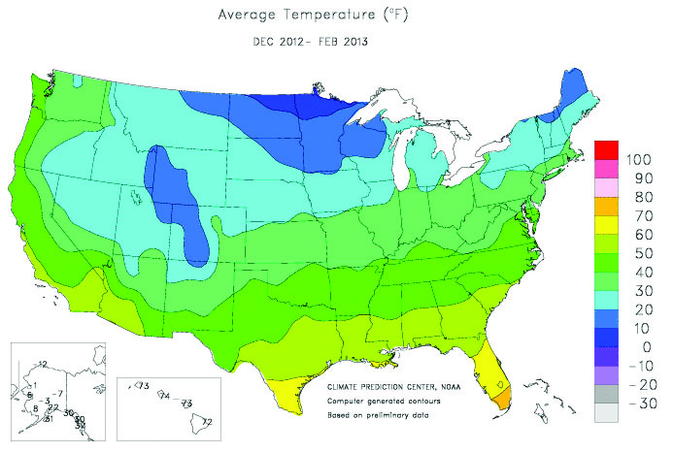
Investigation: Why do some places at the same latitude have different temperature patterns?
What do you notice on these maps of the United States from Lesson 1?

Slide 6
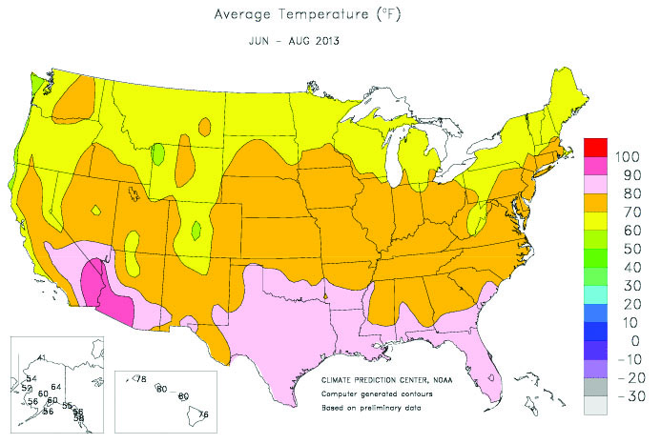
Investigation: Why do some places at the same latitude have different temperature patterns?

Slide 7
Investigation: Why do some places at the same latitude have different temperature patterns?
Point out some places on the US map that show different temperatures at the same latitude.
How many can you locate?
Are the temperatures different in both the winter and the summer?

Slide 8
Investigating temperatures at the same latitude
Using the data in this data table, create a line graph of temperatures in the three cities during one year.

Slide 9
Investigating temperatures at the same latitude
Record the patterns you observe in your line graph.
What is similar about temperatures in each city?
What is different?
Let’s compare our teams’ ideas.

Slide 10
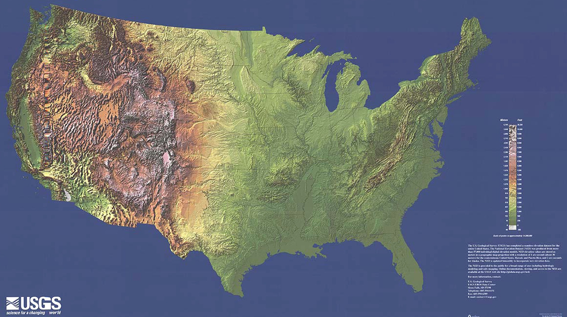
Investigation Summary: Why do some places at the same latitude have different temperature patterns?

Slide 11
Investigation Summary: Why do some places at the same latitude have different temperature patterns?
What do you notice about where each city is located?
Using the features on the map, what do you think might account for the different temperature patterns of these three cities?

Slide 12
Investigation: Why do some places at the same latitude have different temperature patterns?
These are some things we noticed:
San Francisco is close to the Pacific Ocean.
Colorado Springs is near the Rocky Mountains.
St. Louis is in the center of the US and not near either a big body of water or mountains.
What about the locations of these three cities might make a difference in their temperatures? Explain your ideas.

Slide 13
Investigation: Key Science Ideas
Not all places at the same latitude have the same average temperatures.
Therefore, we know that latitude is not the only factor that determines the temperatures at a specific location on Earth.
Other things that might matter are being near a large body of water and elevation.

Slide 14
Lesson Summary: Key Science Ideas
There are different temperatures on Earth because
the Sun’s rays hit certain parts of Earth more directly and other places less directly.
as Earth orbits the Sun, the most-direct angles of sunlight reach different parts of Earth at different times of the year.

Slide 15
Lesson Summary: Lesson Focus Question
Why do some places at the same latitude have different temperature patterns?
Record your answer to the lesson focus question in your science notebook.
Share your ideas with your classmates.

Slide 16
Lesson Summary: Unit Central Question
Why are some places on Earth hotter than others at different times of year?
Talk about the Unit Central Question with your teammates.
Use key science ideas from all of the lessons to share what you have learned.
Be prepared to share your ideas with your classmates.

Slide 17
In the next lesson, you will think about …
Why does being close to an ocean affect the temperature at a particular location?

Slide 18
Link to last lessons: The Sun’s effect on climate
What patterns did we observe on the bar graphs from Lesson 1?
What important science ideas have we learned from our lessons so far?
(State the science ideas in complete sentences.)

