Slide 1
Lesson 6: Holding on to heat
Sun’s Effect on Climate

Slide 2
Link to last lesson
Think about what you learned in our previous lessons.
What factors do we think affect temperatures on Earth?

Slide 3
Lesson 6: Focus Question
Today we will investigate the lesson focus question:
How does being near the ocean or at higher elevation affect air temperature?

Slide 4
Investigation 1: Oceans
Today we will work as a class to think about how living near a large body of water influences our temperatures.
Can you think of why being close to an ocean might affect temperatures?

Slide 5
Investigation 1: Oceans
What are we investigating today?
OVERVIEW OF INVESTIGATION
Part 1. Investigating Temperatures of Land and Water. This investigation will help us think about how nearness to large bodies of water affects average temperature. We will heat samples of soil and water. Observe and describe changes in the temperatures of the soil and water as they are heated and then allowed to cool. Graph your results.
Part 2. Investigating Elevation. This investigation will help us think about how elevation affects average temperatures. We will read Climb to Cold and plot elevation and temperature data on an elevation profile and look for patterns in temperature.

Slide 6
Lab Roles
Role | Student
Timer 1
Timer 2
Baseline Temperature
Baseline Temperature
Temperature at 3:00
Temperature at 3:00
Temperature at 6:00
Temperature at 6:00
Temperature at 9:00
Temperature at 9:00
Temperature at 12:00
Temperature at 12:00
Temperature at 15:00
Temperature at 15:00
Temperature at 18:00
Temperature at 18:00
We need two timers to keep track of when to read the temperatures.
We need temperature readers to read the temperature of the soil and the water, and then check each other’s readings.

Slide 7
How is this model similar to the real world?
Part of the model | What it means in our world
Heat lamp
Heat lamp turned on
Heat lamp turned off
Soil
Water

Slide 8
Investigation 1: Oceans
How does this investigation help us answer our lesson focus question?
How does being near the ocean or at higher elevation affect air temperature?

Slide 9
What patterns did we notice?
Which material gained heat the quickest?
Which material lost heat the quickest?
How is this connected to air temperatures?
 | Baseline | Heating |  |  | Cooling
Material | 0:00 | 3:00 | 6:00 | 9:00 | 12:00 | 15:00 | 18:00
Soil
Water

Slide 10
Investigation 2: Elevation
Why might a place at higher elevation have different temperatures than a place at a lower elevation?

Slide 11
Investigation 2: Elevation
Instructions
Read the story, Climb to Cold.
Complete the data table below each time the team in the story takes an elevation and temperature measurement.
When you complete the story, plot each location’s elevation and temperature on the elevation profile below.
Not all locations will have temperatures, but you can still plot their elevation.

Slide 12
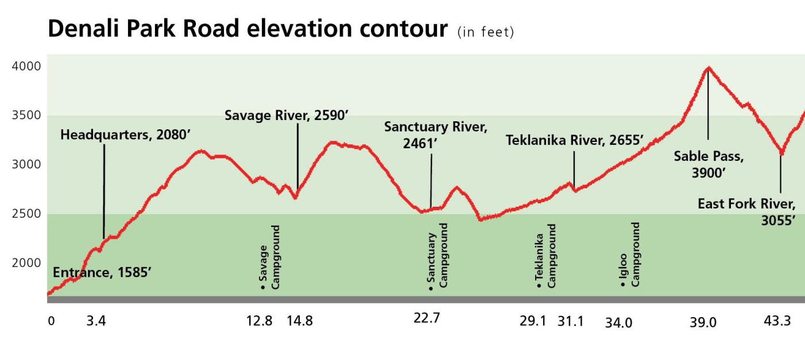
What is an elevation profile?
Image credit: National Park Service

Slide 13
Investigation 2: Elevation
How does this investigation help us answer our lesson focus question?
How does being near the ocean or at higher elevation affect air temperature?

Slide 14
Connecting Oceans, Elevation, and Latitude
How do you think this investigation might connect to the line graphs we drew yesterday?

Slide 15
Using Evidence
Explain:
Why are the average temperatures different in three cities at the same latitude?
Evidence:
What evidence from Investigations 1 and 2 will support your explanation?
Explain:
Evidence:
Be prepared to share your ideas!

Slide 16
Lesson Summary: Science Idea #1
The Sun’s energy hits Earth at different angles. It is more direct close to the equator and less direct closer to the poles. Places that receive more-direct sunlight are warmer than places that received less-direct sunlight.

Slide 17
Lesson Summary: Science Idea #2
Earth is tilted, which changes where direct sunlight is on Earth depending on the time of year. When the Northern Hemisphere receives the most-direct rays, it is summer. When the Northern Hemisphere receives less-direct rays, it is winter. The Southern Hemisphere has opposite seasons.

Slide 18
Lesson Summary: Science Idea #3
Nearness to oceans or higher elevation can influence regional temperatures. Water absorbs and releases heat more slowly, which causes more-moderate air temperatures close to oceans. Land heats and cools more rapidly, which cause more-extreme fluctuations in temperatures. And as we get higher in elevation, temperatures typically get cooler.

