Slide 1
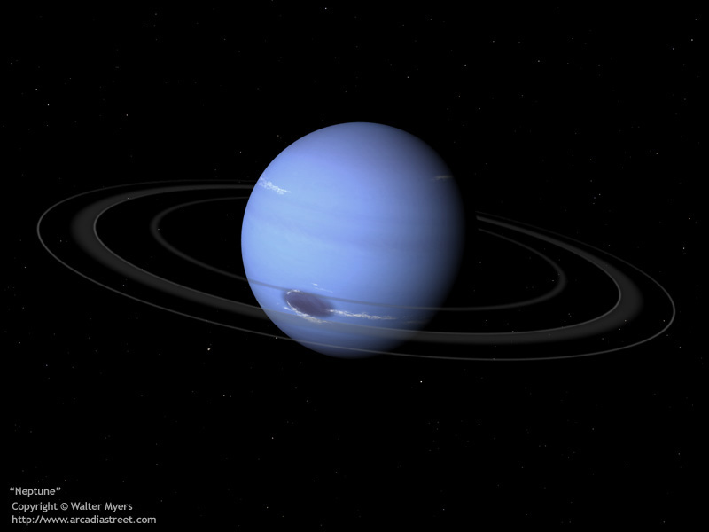
Neptune

Slide 2
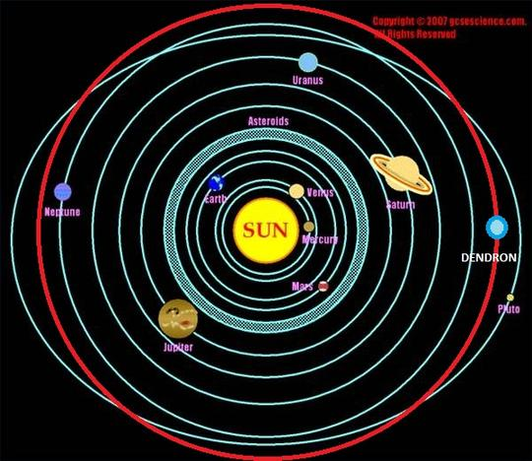
How long is the orbit of Neptune?
What is the length of orbit in Neptune?
The average distance between Neptune and the Sun is 4.50 billion km (about 30.1 astronomical units (AU)), and it completes an orbit on average every 164.79 years, subject to a variability of around ±0.1 years.
How long is Neptunes orbit?
164.79 years
Neptune Neptune orbits much further away from the Sun than the Earth, so its orbit takes much longer. In fact, Neptune takes 164.79 years to orbit around the Sun. That’s almost 165 times longer than Earth takes to orbit the Sun.

Slide 3
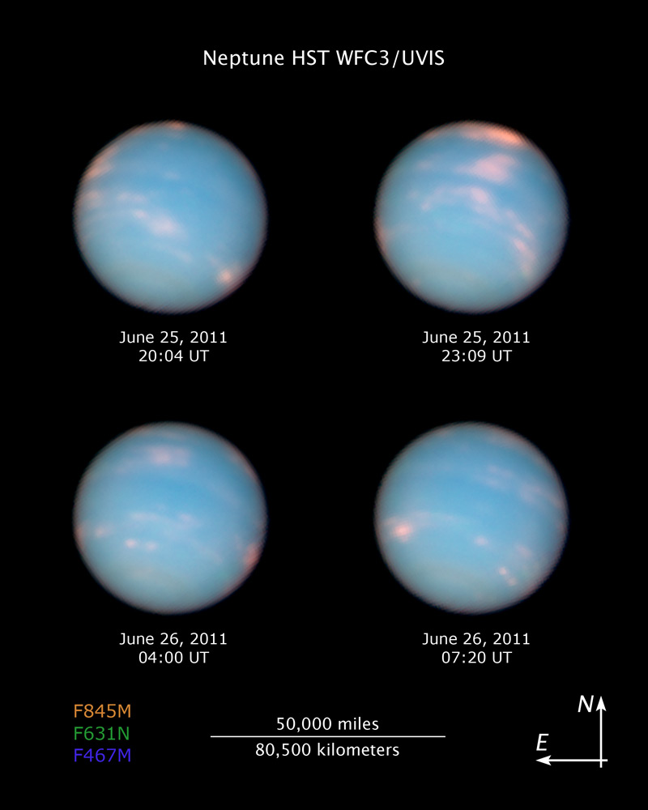
What is the average temperature of Neptune?
At its surface, where the clouds of the planet touch space, the temperature of Neptune can dip down to 55 Kelvin. That’s -218 degrees Celsius. Hot:7000 degrees C

Slide 4
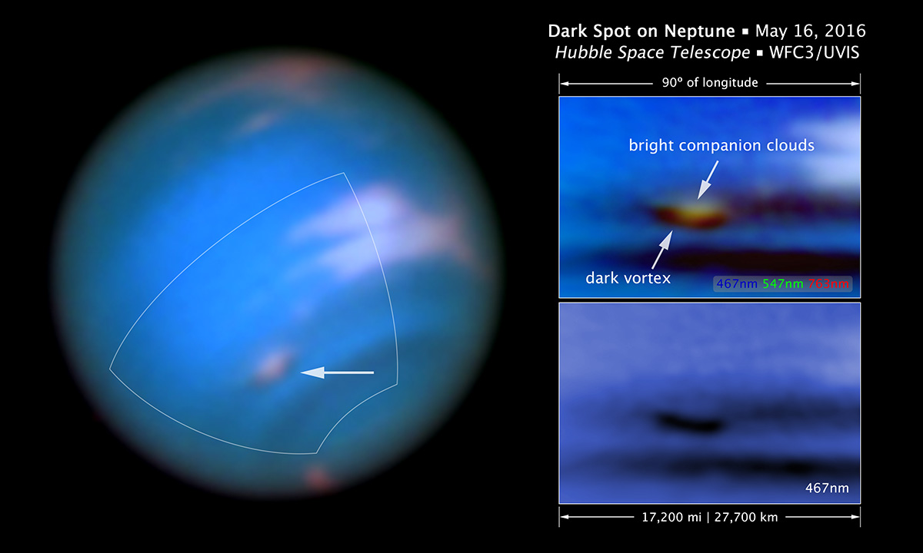
What does Neptune look like?
Another feature of the planet Neptune is its Great Dark Spot. The Great Dark Spot of the planet Neptune is actually a depression in its atmosphere that is surrounded by high cirrus type of clouds. However, this spot does not have stability in its appearance. After a few years of being discovered by the Voyagers, this spot disappeared and in the year 1995, it appeared again in the northern Hemisphere of the planet Neptune. At the time it was first discovered, it appeared to be slowly moving but after the rotation rate of Neptune was finally determined, the Great Dark Spot showed that it does not slowly move with the planet but moves in the direction that is said to be opposite to the spin of the planet at supersonic speeds. The speed is said to be ten times of the Earth’s hurricane speed.

Slide 5
What is gravity like on Neptune
The gravity is 11.15m2

Slide 6
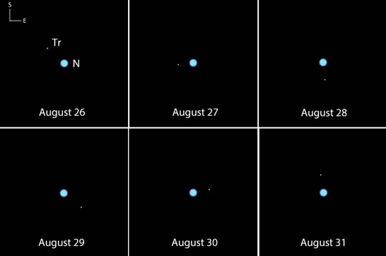
Have we explored Neptune? If we had, what spacecraft, satellites have been sent there?
Humans have explored Neptune by remote control

Slide 7
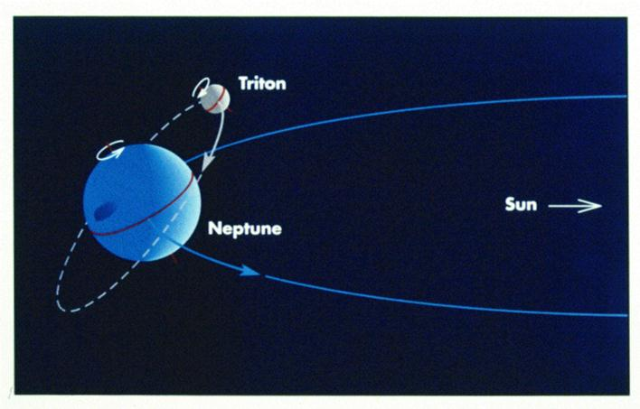
How long is the spin/rotation on Neptune?
The spin/rotation on Neptune is 5,970,000.

Slide 8
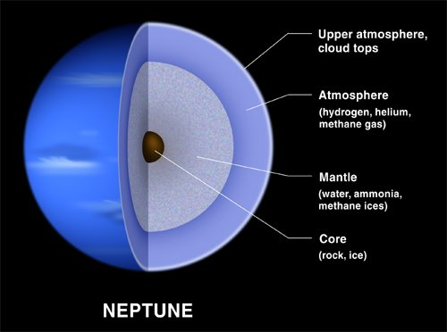
What features have been found on Neptune?
The features that have been found are ice, molten rock, water, liquid ammonia and methane.

Slide 9
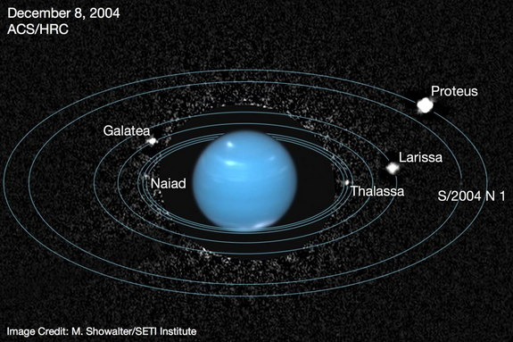
How many moons does Neptune have?
Neptune has 8 moons. Those are Titan, Dione, phoebe, Rhea, Enceladus, Iapetus, Tethys, and Mimas.

Slide 10
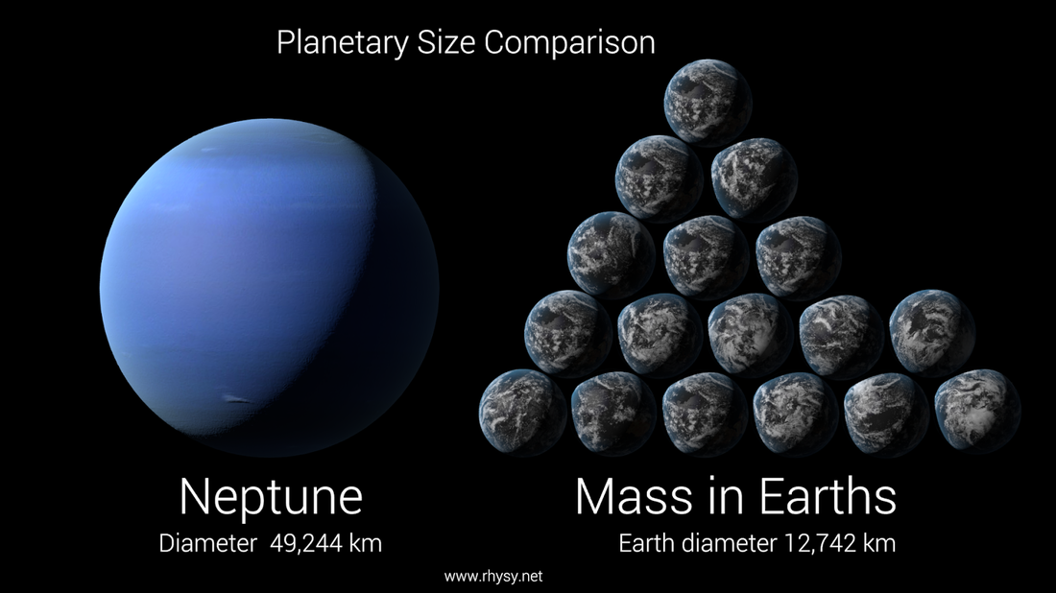
What is the diameter, mass, and mean density of Neptune?
Diameter:49,532 km
Mass:1.0247e26 kg
Mean density:1.64 g/cm3

Slide 11
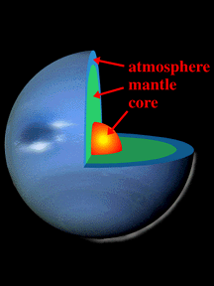
What Type of Atmosphere dose Neptune have?
The planet Neptune Atmosphere is made out of a mixture of Hydrogen, Helium, and Methane.

Slide 12
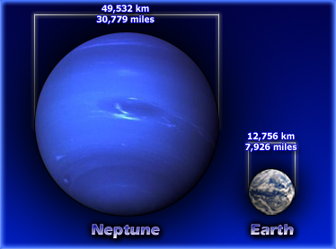
How far is Neptune from the sun?
Neptune is 30.1 Astronomical units away from the sun (4,503,443,661 km).

Slide 13
Three interesting facts about Neptune
1. Neptune has the fastest winds in the Solar System at up to 700km per hour.
2. The is a area on Neptune that is called " Great Dark Spot" which is a giant storm that is half the size of Earth, and can reach the speeds of 700 km per hour.
3. Neptune could hold 60 earths inside it.

