Slide 1
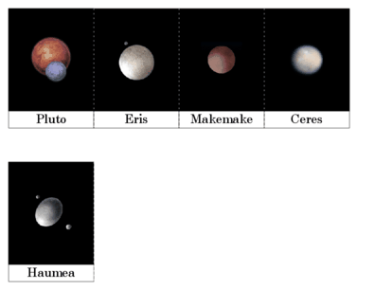
Pluto and the dwarf planets
By AJ, Aidan, Cheryl, and Emma

Slide 2
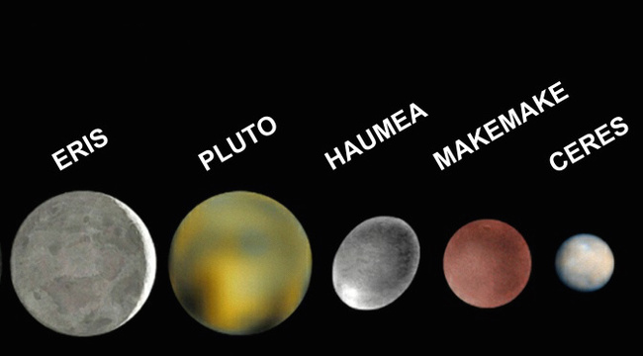
The Dwarf Planets
A dwarf planet is a smaller planet that shares an orbit around the sun such as an asteroid comets.
Scientists believe there may be as many as a few 100 other dwarf planets in the Kuiplir Belt.
The 5 discovered dwarf planets in our solar system are Pluto, Ceres, MakeMake, Eris, and Haumea.

Slide 3
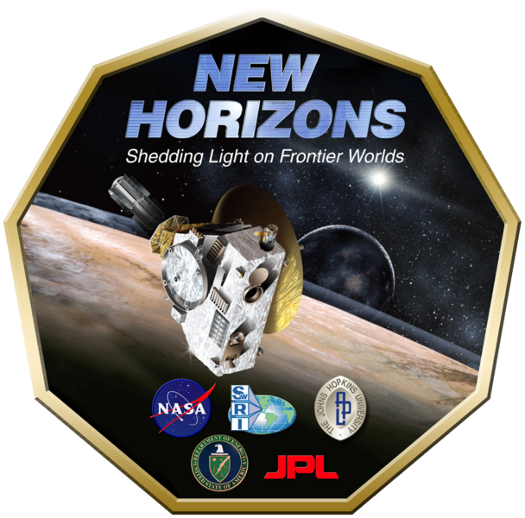
Exploration of the Dwarf Planets
As of right now, we have sent a spacecraft, New Horizons, to Pluto.
It launched on January 19th, 2006 and completed a flyby on July 14th, 2015.
The goal of the New Horizons mission was to look at Pluto and its moons.
It discovered that Pluto had flowing ice on its surface.
There was a mission sent to the dwarf planet Ceres named Dawn.
It was launched on September 27th, 2007.
It is currently orbiting one of Pluto's moons, Charon.
The goal of the mission is to learn more about the makeup of our early solar system.
We haven't sent a direct mission to any of the other dwarf planets.

Slide 4
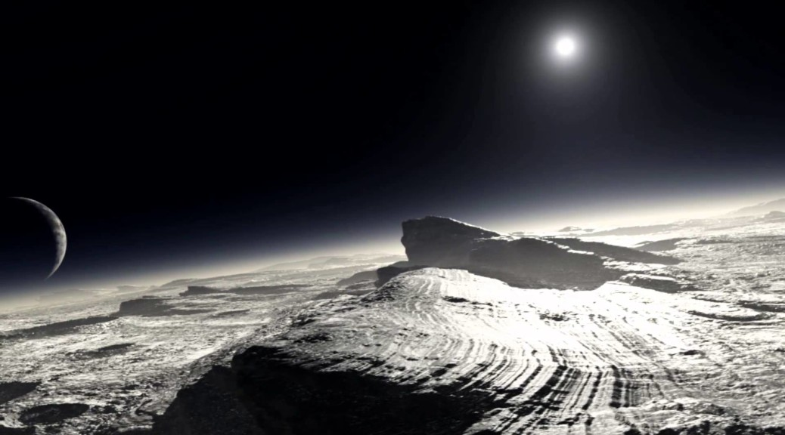
Features on the Dwarf Planets
Pluto is solid ice, one mountain named Norgay Montes (or Norgay Mountain), and it is also one-third water. It is rocky and has a rough terrain.
Scientists believe that the dwarf planet Eris is composed of frozen water and methane. They also think that the atmosphere has frozen to the surface of the planet and when it gets close to the sun, it will melt revealing a rocky surface similar to Pluto.
The Dawn mission found a cryovolcano called Ahuna Mons, nicknamed the "Lonely Mountain" on Ceres. A cryovolcano is a volcano that releases cold, salty-mud water instead of lava. Ceres also has a crust made of ice.
MakeMake is most likely made of frozen methane or solid ice.
Haumea, like all of the other dwarf planets, is believed to be made of ice. The physical features on the surface are still unknown.
Pluto's Surface

Slide 5
The Atmospheres and the Gasses the Atmospheres Contain
Pluto has an atmosphere that is made of nitrogen. It is not there year round however. As the planet warms up, the nitrogen evaporates but the cooler Pluto gets, the nitrogen freezes and returns to being the atmosphere.
Eris's atmosphere has frozen into a glaze that covers the planet. However, we don't know what that "glaze" is composed of.
Scientists believe that MakeMake has no atmosphere but could create one, like a comet, when it approaches the point in its orbit when it is closest to the sun.
Scientists still don't know if Haumea has an atmosphere.
The Dawn mission detected a weak atmosphere on Ceres. They think it is made by solar wind hitting water molecules.

Slide 6
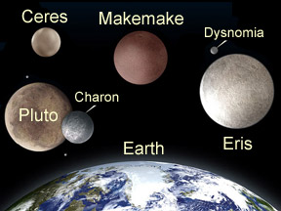
The Average Temperature on the Dwarf Planets
The average temperature on Pluto –380° Fahrenheit. The lowest temperature recorded is about –400° Fahrenheit. The highest temperature recorded is -360° Fahrenheit.
Makemake's average temperature is about -406° Fahrenheit.
The average surface temperature on Eris is -243° Fahrenheit.
The average surface temperature of the dwarf planet Haumea is -402° Fahrenheit.
The highest temperature on the dwarf planet Ceres is -38° Fahrenheit. The average surface temperature during the day is -100° Fahrenheit and during the night its about -225° Fahrenheit.

Slide 7
The Gravity on the Dwarf Planets
The surface gravity on Pluto is .66 m/s². A 100 pound man would weigh 6 lbs on Pluto.
The surface gravity on Ceres is .27 m/s². A 100 pound man would weigh about 12 pounds on Ceres.
The dwarf planet Eris has .65 m/s². A 100 pound person would weigh about 29 pounds.
There is .44 m/s² surface gravity on Haumea. A 100 pound person would weigh approximately 20 pounds on the dwarf planet.
The surface gravity on MakeMake is .5 m/s². A 100 pound man would weigh 23 pounds on MakeMake.
m/s²= meters per second squared

Slide 8
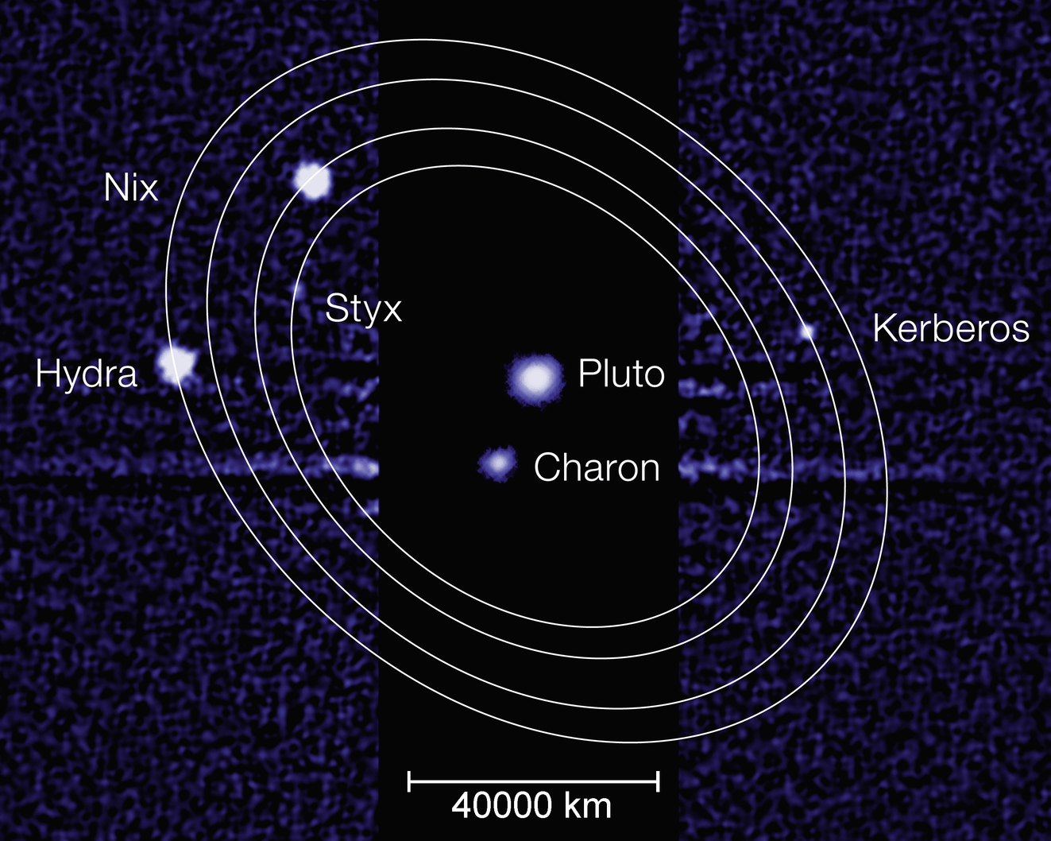
The Moons that Orbit the Dwarf Planets
Pluto:
-Charon: It was discovered in 1978 and is also called Pluto1.
-Hydra: It was discovered in June of 2005 and was visited in July of 2015.
-Nix: It was discovered in June of 2005.
-Kerberos: It was discovered on June 28th, 2011.
-Styx: It was discovered on June 26th, 2012.
Eris
-Dysnomia: It was discovered in 2005, and is the only known moon to Eris.
MakeMake
-S/2015 (136472) 1: It was discovered in April of 2015, and is the only known planet to MakeMake.
Haumea
-Hi'aka: It was discovered on January 26th of 2005.
-Namaka: It was discovered on June 30th of 2005.
Ceres
-No known moons.

Slide 9
The Distance from the Sun to the Different Dwarf Planets
At the closest point of its orbit, Pluto gets to within 4.44 billion km from the Sun. At its most distant point of its orbit Pluto gets to within 7.38 billion km of the Sun. The average distance from the Sun is 5,906,292,480 km.
The average distance from Eris to the Sun is 14,062,199,874 km.
The average distance from the Sun for Haumea is 6,447,668,226.7 km. The furthest away it can get is 7,704,290,340.5 km.
The approximate distance from Ceres to the Sun is 413,832,587 km. The closest it will get to the Sun is 380,995,855 km. The furthest away it will get from the Sun is 446,669,320 km.
The average distance from the Sun to MakeMake is 6,844,102,584.1 km. The closest it will ever get to the Sun is 5.761 billion km. The furthest away from the sun it will get is 7.940 billion km.

Slide 10
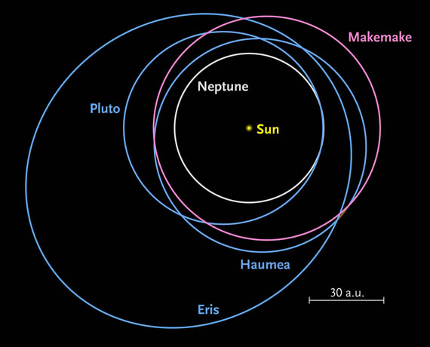
The Time it Takes the Dwarf Planets to Orbit the Sun
It takes Pluto 248 Earth years to orbit the Sun one time.
The time that it takes the dwarf planet Eris to orbit the sun one time is 557 Eath years.
It takes 305 Earth years for Makemake to orbit the Sun.
The dwarf planet Haumea takes about 282 Earth years to orbit the Sun
It takes Ceres 4.6 Earth years to orbit the Sun once.

Slide 11
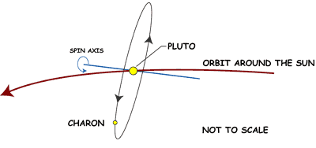
The Time it Takes for the Dwarf Planets to Rotate
Pluto's rotation takes about 6.4 Earth days (6 days 9 hours and 36 minutes) to complete.
Haumea rotates very rapidly and has the shortest day of all the dwarf planets, only 3.9 hours.
One day on the dwarf planet Ceres lasts 9 hours.
Makemake's day lasts 22.5 hours.
A day on Eris takes 29.5 hours.

Slide 12
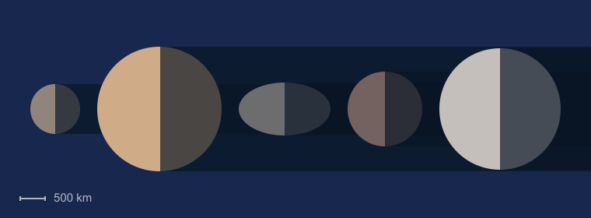
The Diameter, Mass, and Density of the Dwarf Planets
The diameter of Pluto is 2,370 km. The mass of Pluto is 1.30900 x 10²² kg. And finally, the density of the dwarf planet Pluto is 1.88 g/cm³.
The diameter of Ceres is 950 km. The mass of Ceres is 8.598 x 10²⁰ kg. The density of Ceres is 2.08 g/cm³.
The diameter of Eris is 2,326 km. The mass of Eris is 1.66 x 10²² kg. Lastly, the density of Eris is 2.52 g/cm³
Makemakes diameter is 1,434 km. The mass of the dwarf planet is between 2 x 10²¹ kg and 5 x 10²¹ kg. The density of MakeMake is about 1.7±0.3 g/cm³​.
Haumea's equatorial diameter is between 1,518 km and 1,960 km. The mass is about 4.01 x 10²¹. The density is some where between 2.6 g/cm³ and 3.3 g/cm³.
It difficult for scientists to accurately determine most of the dwarf planets masses and densities.
g/cm³= grams/centimeters cubed
Dwarf planets from left to right Ceres, Pluto, Haumea, MakeMake, and Eris.

Slide 13
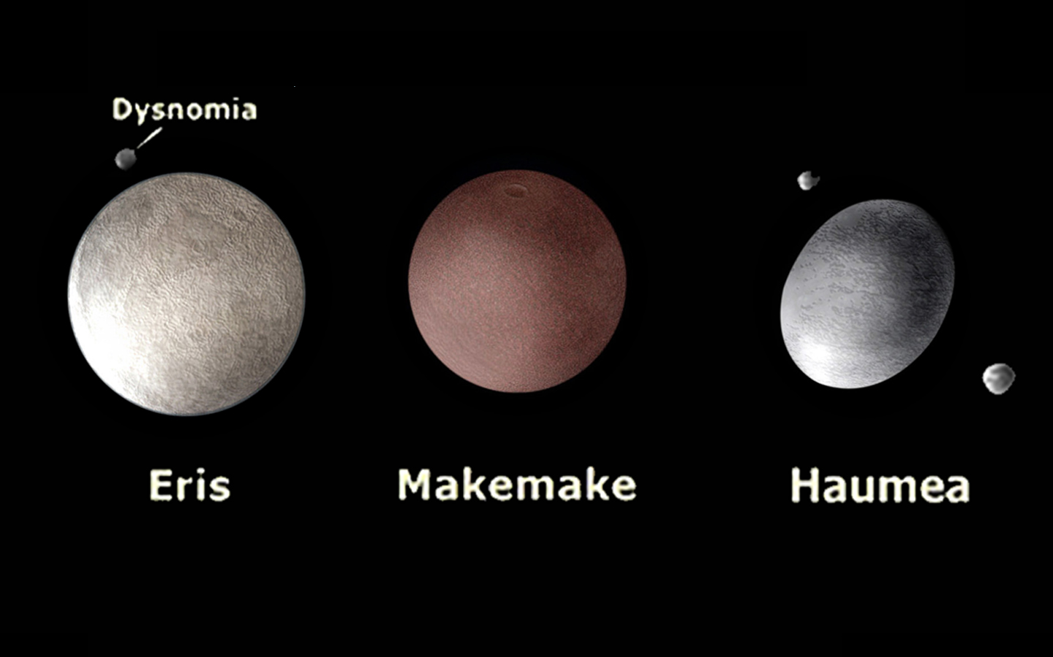
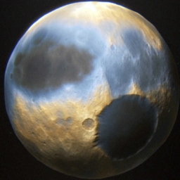
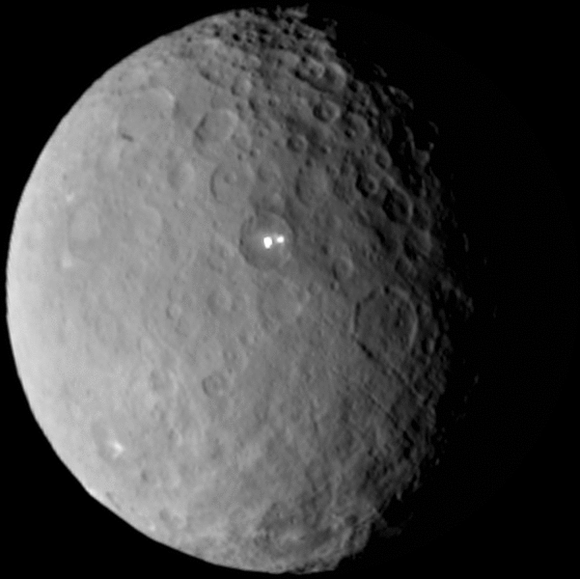
Fun Facts about the Dwarf Planets
If you picked up every asteroid in the asteroid belt and put them inside Eris, they would all fit with room to spare.
Pluto is named after the Roman god of the Underworld. Its moons names come from Greek origins. Pluto is the largest dwarf planet.
Haumea is the third brightest object in the Kuiper belt, after the dwarf planets Pluto and Makemake.
Pluto
Ceres

