Slide 1
Protect the skin you’re in
A Lab about Ultraviolet (UV) Radiation

Slide 2
DAY ONE
Project Purpose
Project Introduction
Choose Group
Choose Topic

Slide 3
Project Purpose
I don’t know how to put this, but your skin is kind of a big deal!
Understand what the Electromagnetic spectrum is, including Ultraviolet Light
Understand the affects of UV radiation and the effects it could have on your body
Skin cancer rates are on the rise - More people die every year from skin cancer than they do from smoking
Your skin is your largest organ and protects your body and is one of it’s first defenses.

Slide 4
“Dear 16 year old Me”
https://www.youtube.com/watch?v=_4jgUcxMezM

Slide 6
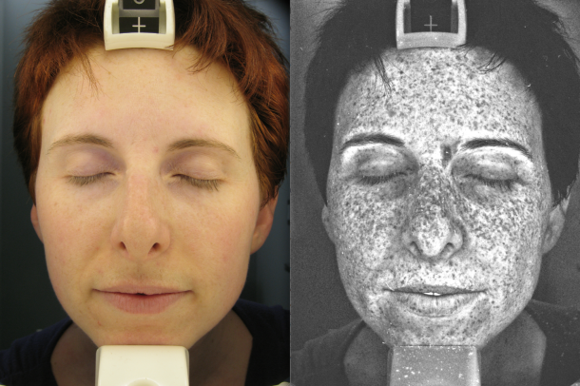

Slide 7
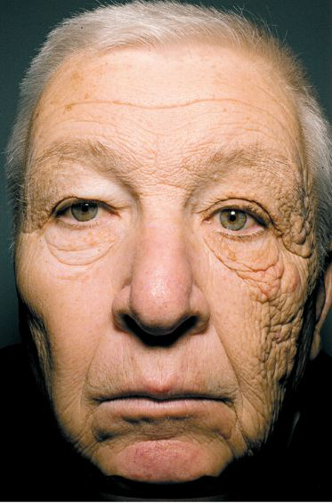

Slide 8
Science Standard
8.3.2.2.1: Describe how the composition and structure of the Earth’s Atmosphere affects energy absorption, climate and the distribution of particulates and gases.

Slide 9
Finished Product
Completed experiment with results (done as a group, but each individual needs to record)
Completed scientific method (all parts) (done as a group, but each individual needs to have their own lab write-up)
Completed visual display (1 per group)
Completed presentation (your group will present to the class on what you did and what you found out) (each group member needs to have a speaking part)

Slide 10
You will be provided with…
Time to experiment
Time to create a visual display and prepare a presentation
UV emitting black light
UV color-changing beads (and a rating scale to determine color change)
Some Background Information on Black Lights, The Electromagnetic Spectrum and UV color-changing beads
Science Display Board and art supplies to create a visual display

Slide 11
First steps (cont)…
Make a plan for bringing in materials
Who in your group already has supplies you need?
Does anything need to be purchased?
ONLY buy supplies if they will be used by you or your family after the project!
Supplies should be brought in no later than Friday, March 4th.
Bring your supplies in ASAP in a bag labeled with your name
Your teacher will keep them in a safe spot and ONLY YOU and YOUR GROUP will have access to them

Slide 12
First steps…
Find a group
Up to 4 people/group
Working alone is ok, but A LOT of work
Choose people interested in testing the same thing
Decide on a topic
What are you interested in?
What supplies do you have available?
The topic is your choice, unless you come without supplies of your own
Unsure…ideas on an upcoming slide…
By the END OF THE HOUR…Tell your teacher who you are working with and what your topic idea is

Slide 13
Topic Ideas
** Make sure when choosing a topic, only 1 variable is changed (Example: Testing different SPFs of sunscreen, then brand and application type should be kept the same)**
Different brands of sunscreen
Different SPF levels of sunscreen
Different fabrics/materials
Expired Vs. New sunscreen
Different types of sunglasses
What else can you think of?

Slide 14
DAY TWO
Write a Question
Background Information

Slide 15
Focus Question
How do(es) (your topic goes here) affect the color change in UV sensitive beads?
Example:
How do different levels of SPF affect the color change in UV sensitive beads?

Slide 16
Background Information
Take notes on the Electromagnetic Spectrum
Read the background information sheet provided by your teacher to get information about UV light, SPF, UV color changing beads and Black lights
Any information specific to your topic, will need to be researched by you.

Slide 17
Background Information (cont)
Using all the information you found on your topic, write 2+ paragraphs
Paragraph 1
Information from ALL provided research (electromagnetic spectrum, uv light, spf, black lights, uv sensitive beads)
Paragraph 2
Research you conducted specific to your topic

Slide 18
DAY Three
Figure out Variables, Control & Constants
Form a Hypothesis
Experiment

Slide 19
Figuring out Variables, the Control & Constants
Independent Variable: The factor in your experiment you change
Dependent Variable: The factor in your experiment you are watching for a change in.
Control: The factor in your experiment that you do not change and use to compare to
Constants: The factor(s) in your experiment that you keep the same

Slide 20
Writing a Hypothesis
Your hypothesis should answer your question
Use the correct format
We believe that ________________________________
Be specific and include the independent and dependent variables
Example: We believe that with a higher SPF level of a sunscreen, the less ultraviolet radiation will be absorbed therefore limiting the color change of the uv sensitive bead.
Make sure this is done BEFORE YOU EXPERIMENT
If your hypothesis is refuted at the end…it’s OK!

Slide 21
Things to consider when experimenting
Use a control – bead with nothing done to it
Complete multiple trials for more accurate results
Limit the number of variables you change
Test each bead, for each trial, at the same distance (no more than ½ inch from light) from the black light and for the same length of time
Use only 1 color of bead

Slide 22
Things to consider when experimenting
Use only 1 color of bead
Record your results in a neat and organized data table
You will only be given a few beads, so beads may need to be washed and dried between trials.
If you’re applying a product to the bead, use the same amount of product.
Let the bead return to its original color before the next trial.
Take pictures of your experiment and your results

Slide 23
Things to consider when experimenting
Use the provided “Bead Rating Scale”. (0.5 increments may be used when recording.
Data should be collected immediately after testing.
Your control must be tested with every trial

Slide 24
DAY FOUR
Finish Lab Write-up

Slide 25
Material List & Procedure
What supplies did you use to conduct your experiment?
List all supplies you used using bullet points
What did you do to conduct your experiment?
Write a detailed and numbered procedure on how you conducted your experiment.
Have someone else from another group read it to make sure it makes sense…others should be able to easily follow your procedure to conduct the same experiment exactly as you did it.

Slide 26
Conclusion
What did you find out?
Write a paragraph summarizing your results
Include:
Restatement of your question
Restatement of your hypothesis
Support or Refute? Did you agree or disagree with your hypothesis and why?
What could have caused errors in your experiment?
What else would you be interested in testing or how could you expand this experiment?

Slide 27
DAY FiVE & Six
Prepare your Visual Display and Presentation

Slide 28
Presentation
Decide who will talk about what – everyone should have a speaking part
Needs to be included in presentation:
Your Question
Your hypothesis
What you did (your procedure)
What you found out (your data and parts of your conclusion)

Slide 29
Summary on presentations
Paragraph 1: topics covered during presentations. Which of these products seemed to work best? Which did not work the best?
Paragraph 2: What are some ways/products you use to protect yourself from the sun? After hearing these presentations, will you continue to use these products? Why or why not?
** If you say you don’t use anything, what products would you want to try to use to help protect you from UV radiation?

