Slide 1
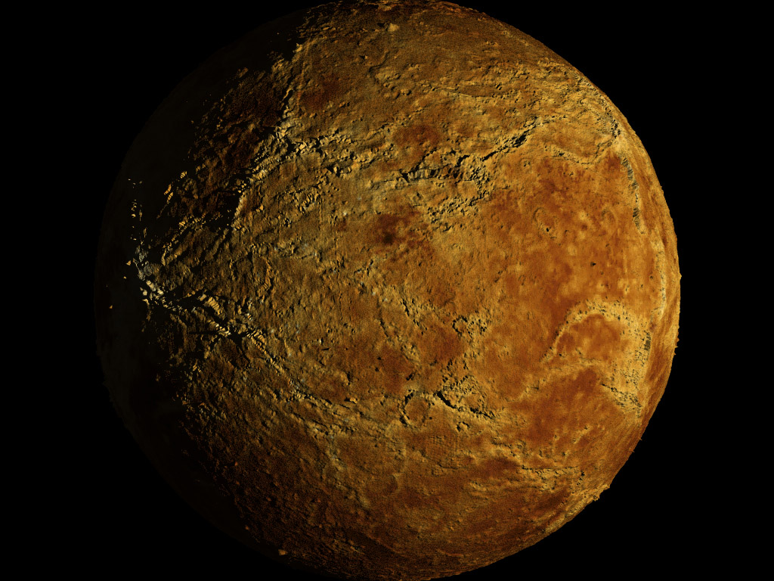
Venus
Elise Egbert, Abbi Moran, Zinash Valen

Slide 2
Venus Visual
Venus is yellow, but at some angles can look red or a tannish color.

Slide 3
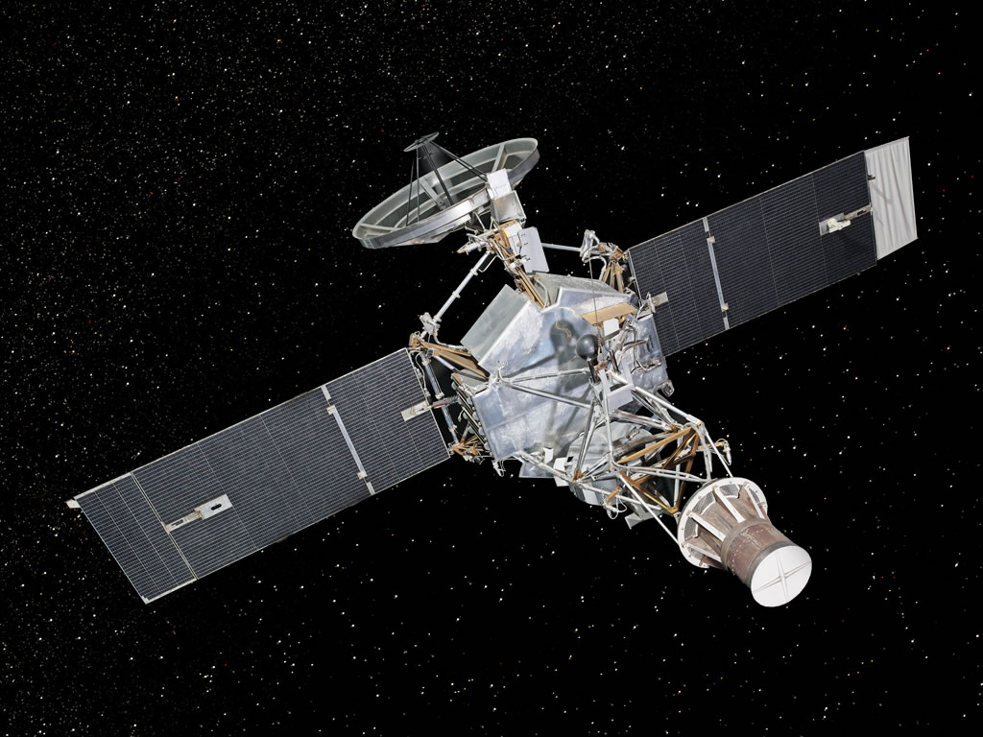
Exploration of venus
The first spacecraft to visit Venus was Mariners 2 in 1962. Since then Venus has had more than 20 spacecraft visits. Venus 9 returned the first photographs of the surface. Magellan produced detailed maps of Venus' surface using radar.
Mariners 2

Slide 4
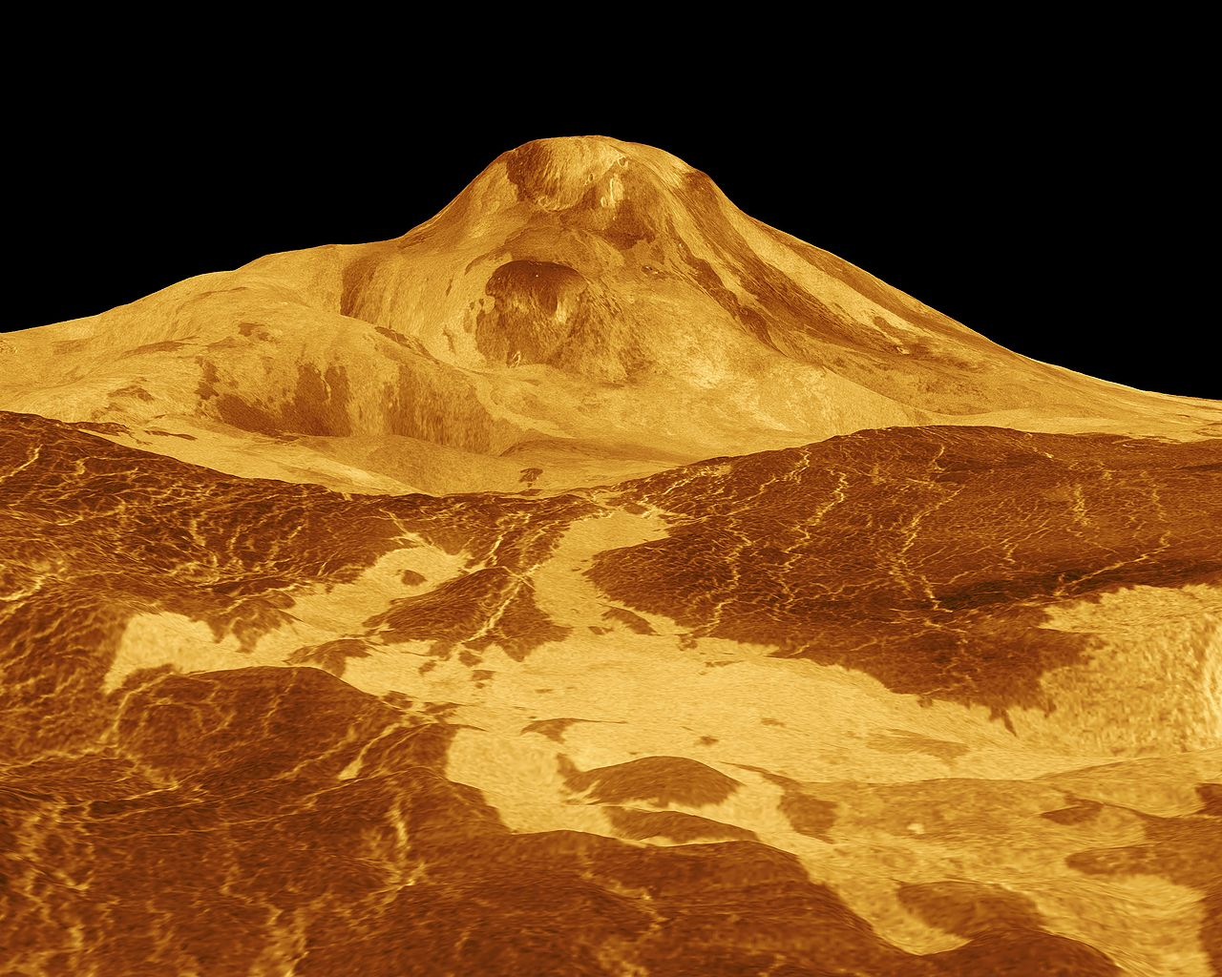
Features of Venus
Venus was shaped by extensive volcanic activity. It has many more volcanoes than Earth. There are lightning storms in Venus' atmosphere, but it never rains (except in the form of sulfuric acid). Venus has almost 1000 craters and has occasional infrared hot spots.

Slide 5
Temperature of Venus
The average temperature of Venus is 460 degrees Celsius. The temperature does not vary at the poles or during day or night.

Slide 6
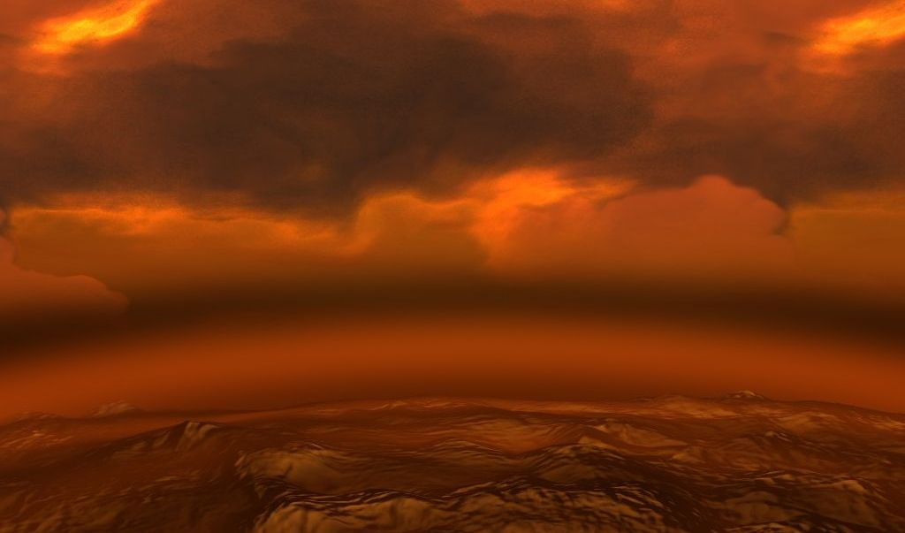
Venus Atmosphere
Venus' atmosphere is made up mostly of Carbon Dioxide. It is a much denser and warmer atmosphere than Earths'.

Slide 7
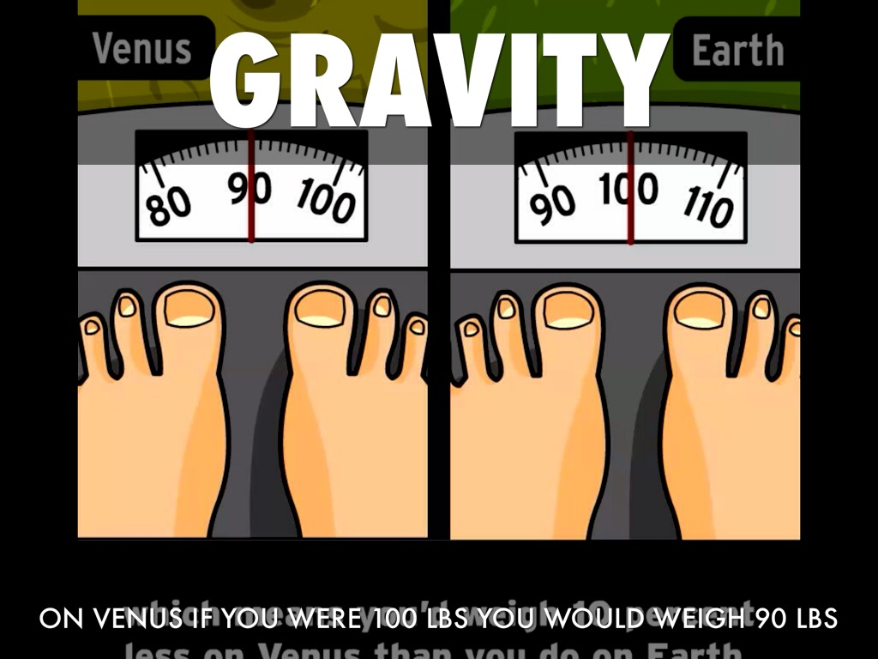
Gravity of Venus
Venus has about 90% the gravity here on earth. Venus's gravity is 8.87 m/s(squared) compared to the gravity of Earth 9.78 m/s (squared).

Slide 8
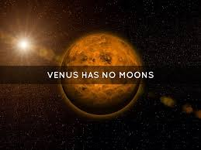
Venus Moons
Venus has no moons. Venus and Mercury are the only planets that don’t have any moons.

Slide 9
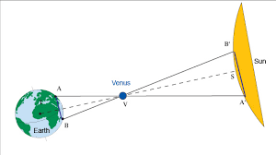
Distance from the sun
Closest- .718 AU
Farthest- .728 AU
Average- .722 AU
*AU- astronomical units

Slide 10
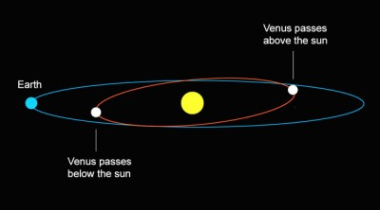
Revolution/orbit of Venus
Venus has the most circular orbit in the entire solar system. In mathematical terms, the eccentricity of Venus is less than 0.01. A year on Venus lasts 233 days.

Slide 11
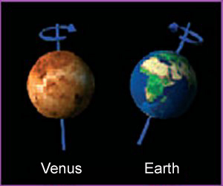
Venus Rotation
Venus rotation is very slow compared to Earths' rotation. One day on Venus, which is one rotation, takes 243 Earth days. Another unique thing about Venus' rotation is that it rotates backwards.

Slide 12
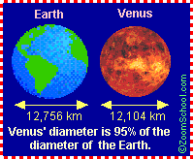
density
Diameter: 12,103.6 km
Mass: 4.869e24 kg
Density: 5.243 g\cm3

Slide 13
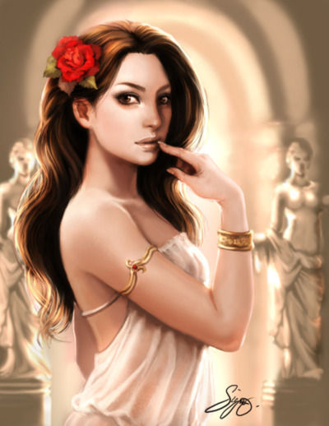
More Venus information
Many cultures have identified the planet Venus with their respective god of love and beauty. Venus is the Roman name of goddess of love, known as Aphrodite in Greek Mythology.
Venus to some cultures is called the evening and the morning star, two separate celestial objects. Babylonians confirmed that both the evening and the morning star are the same object.
Scientists believe that Venus and Earth share a similar internal structure- a core, mantel, and crust. The Venusian core is believed to be at least partially liquid because the two planets have been cooling at about the same rate.

